Slide 1
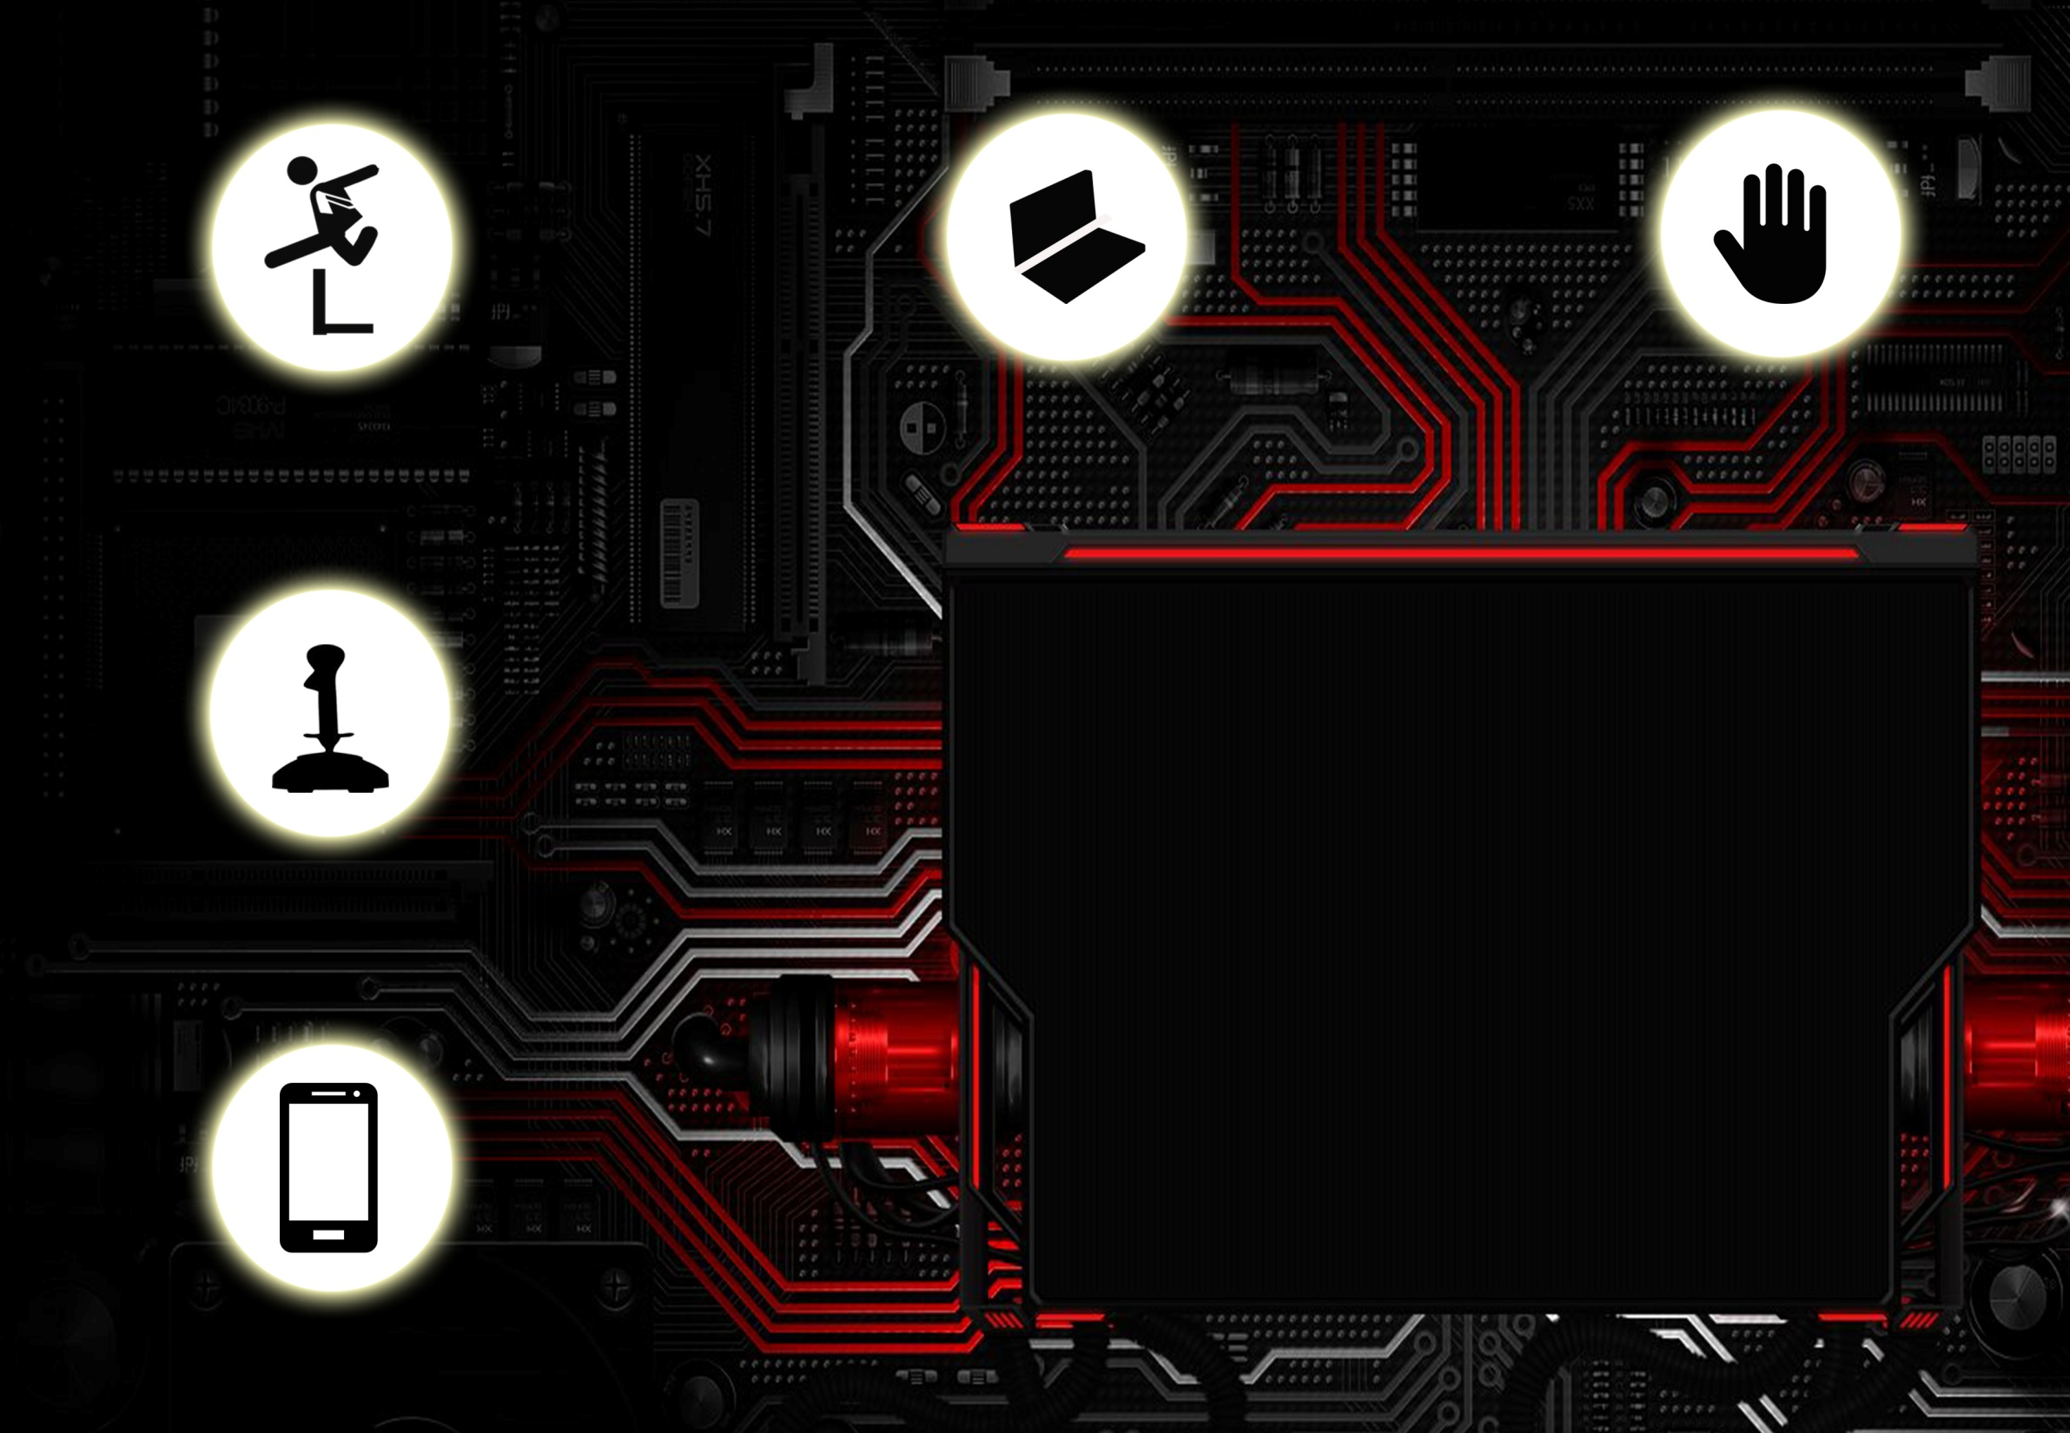
Kit Description and Chassis Attachments
IMPLEMENTATION SESSION

Slide 2
Components of the Kit :
1 Chassis
2 Motors
1 Castor Wheel
2 Wheels
8 AA Batteries
2 AA Battery Holders
2 Battery Clips
ADXL335 accelerometer
1 U Clamp
1 Arduino Uno (Atmega 328)
USB to Serial Cable
2 Motor Driver Boards
1 Ultrasonic Sensor
20 M-M Jumper Wires
10 M-F Jumper Wires
Burg Strips
Screw Driver

Slide 3
Components of the Kit :
1 Aqua Bot Chassis
Bluetooth Module
2 Propellers
2 micro DC motors
1 Dual Shaft Motor
2 Cycle Spokes

Slide 4
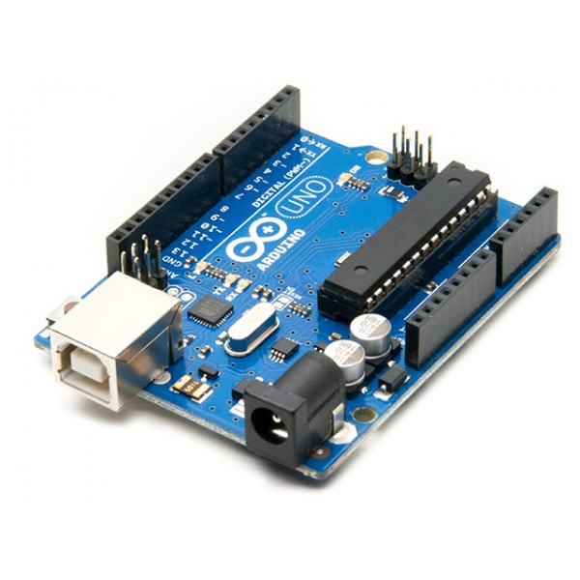
Components of the Kit :

Slide 5
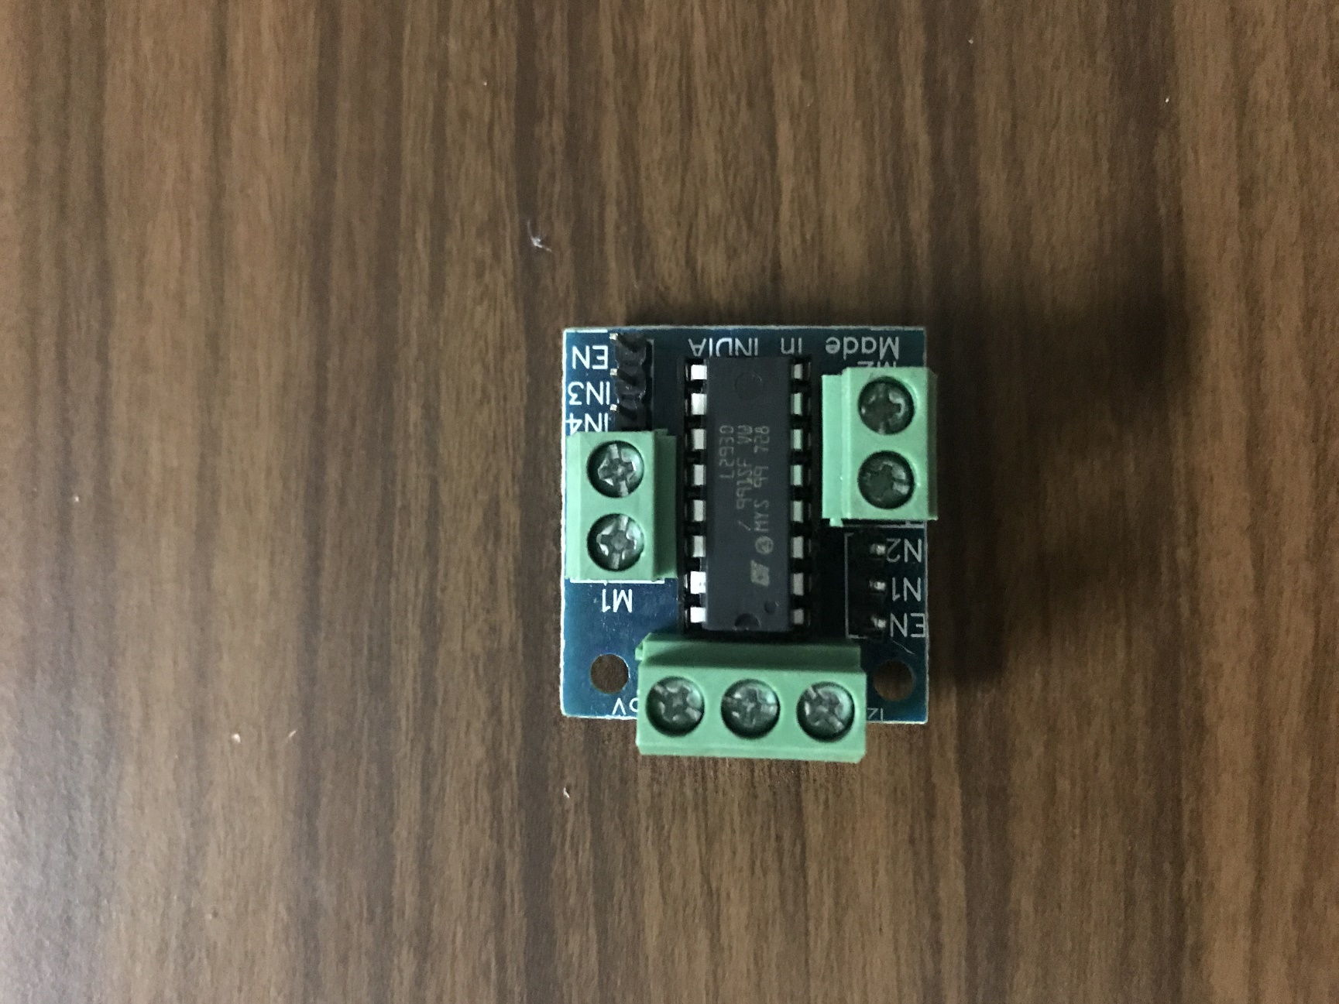
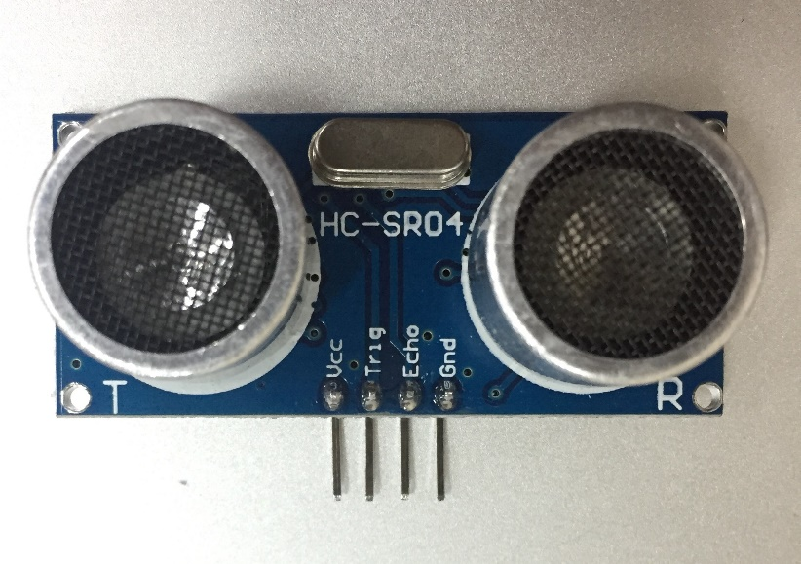
Components of the Kit :

Slide 6
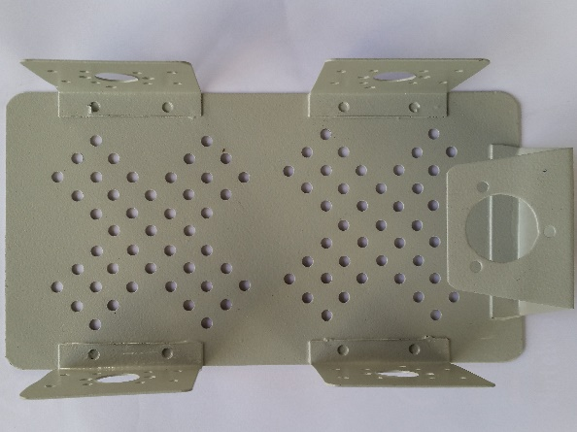
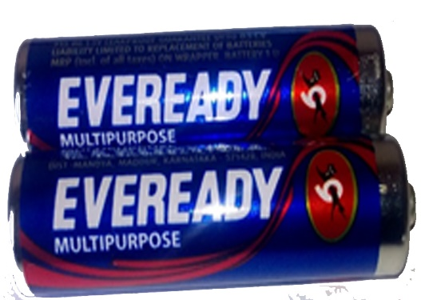
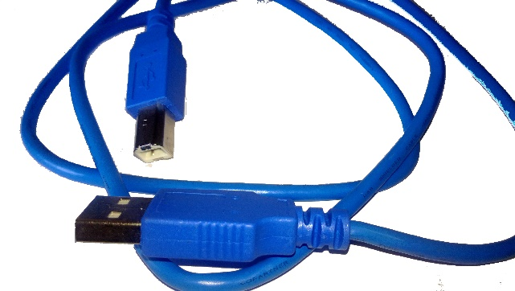
Components of the Kit :
Chassis
USB to Arduino Cable

Slide 7
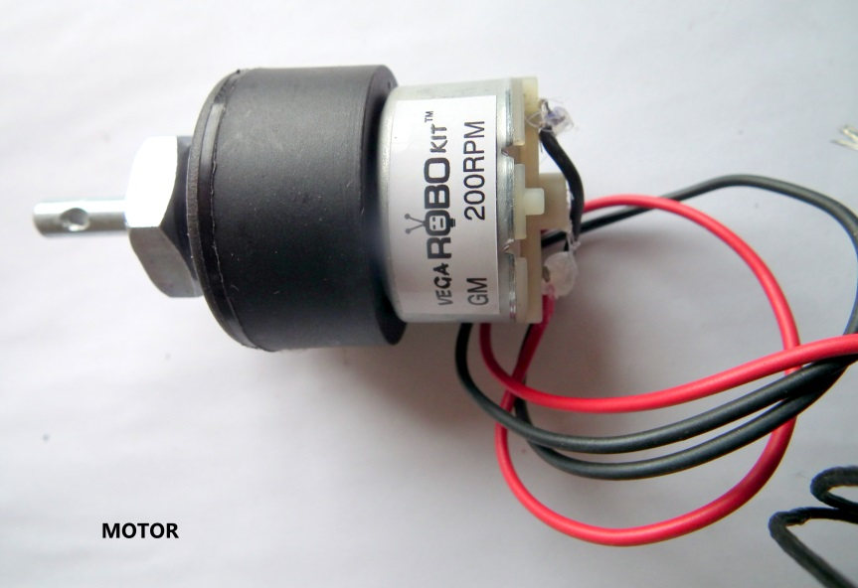
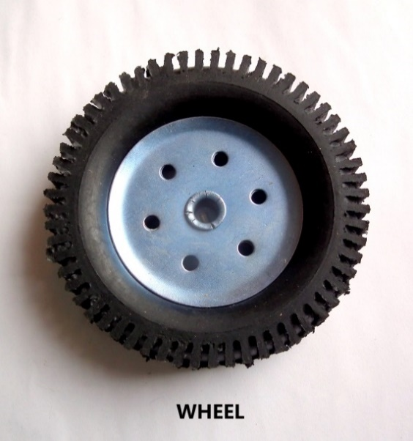
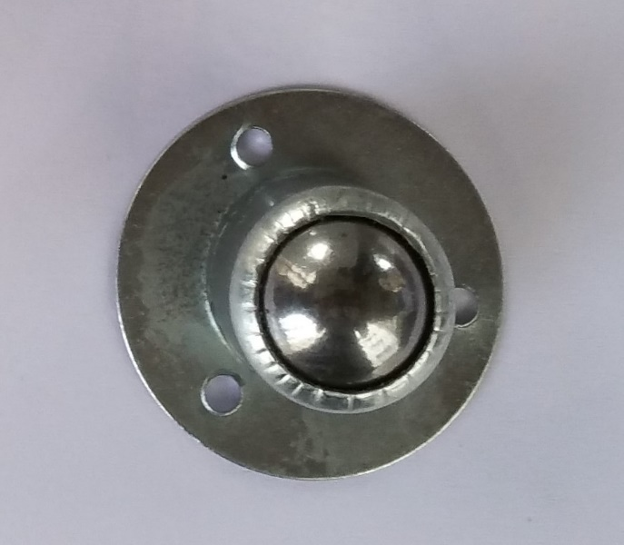
Components of the Kit :

Slide 8
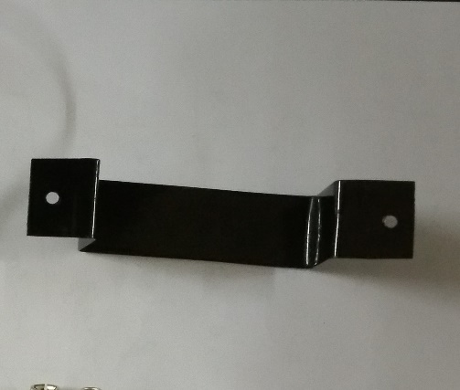
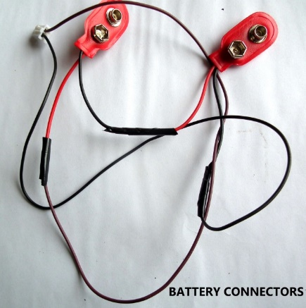
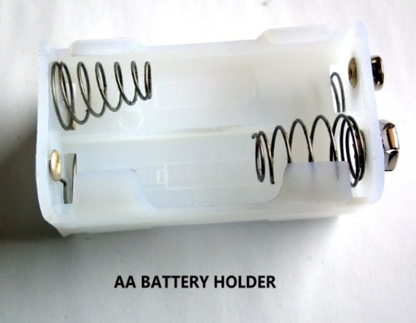
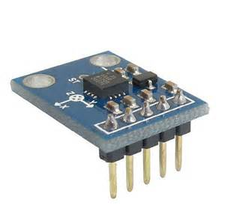
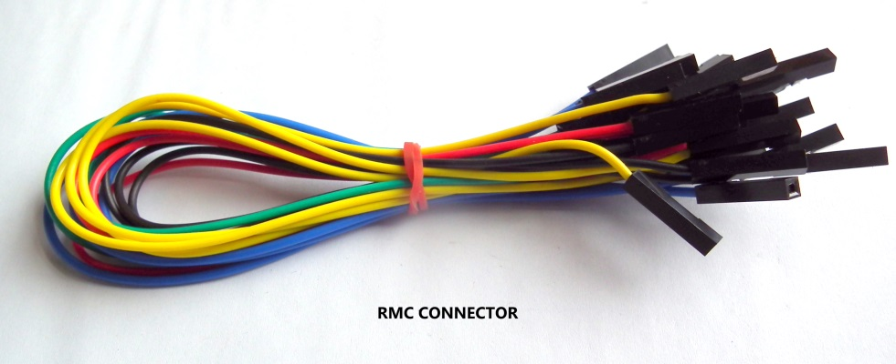
Components of the Kit :

Slide 9
Basic Chassis Attachments :
Attach the following to the chassis using screws and spacers and nuts:
Castor wheel
Motors to chassis
Wheels to motor shaft
Put the batteries in the battery holder
Place the battery holder in the U-Clamp and then attach the U-Clamp to the lower part of the chassis.

Slide 10
CASTOR WHEEL:
Attach the Castor wheel
to the chassis using screws and spacers

Slide 11
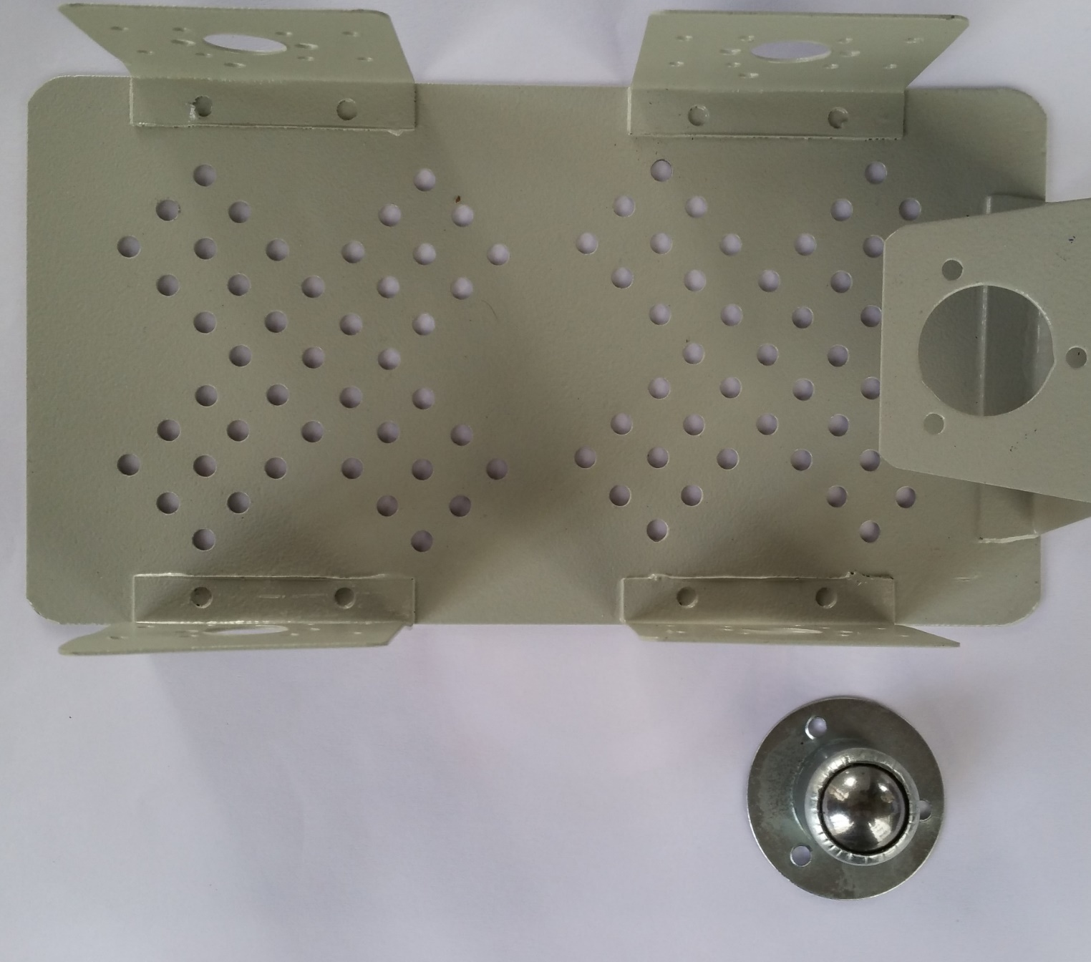

Slide 12
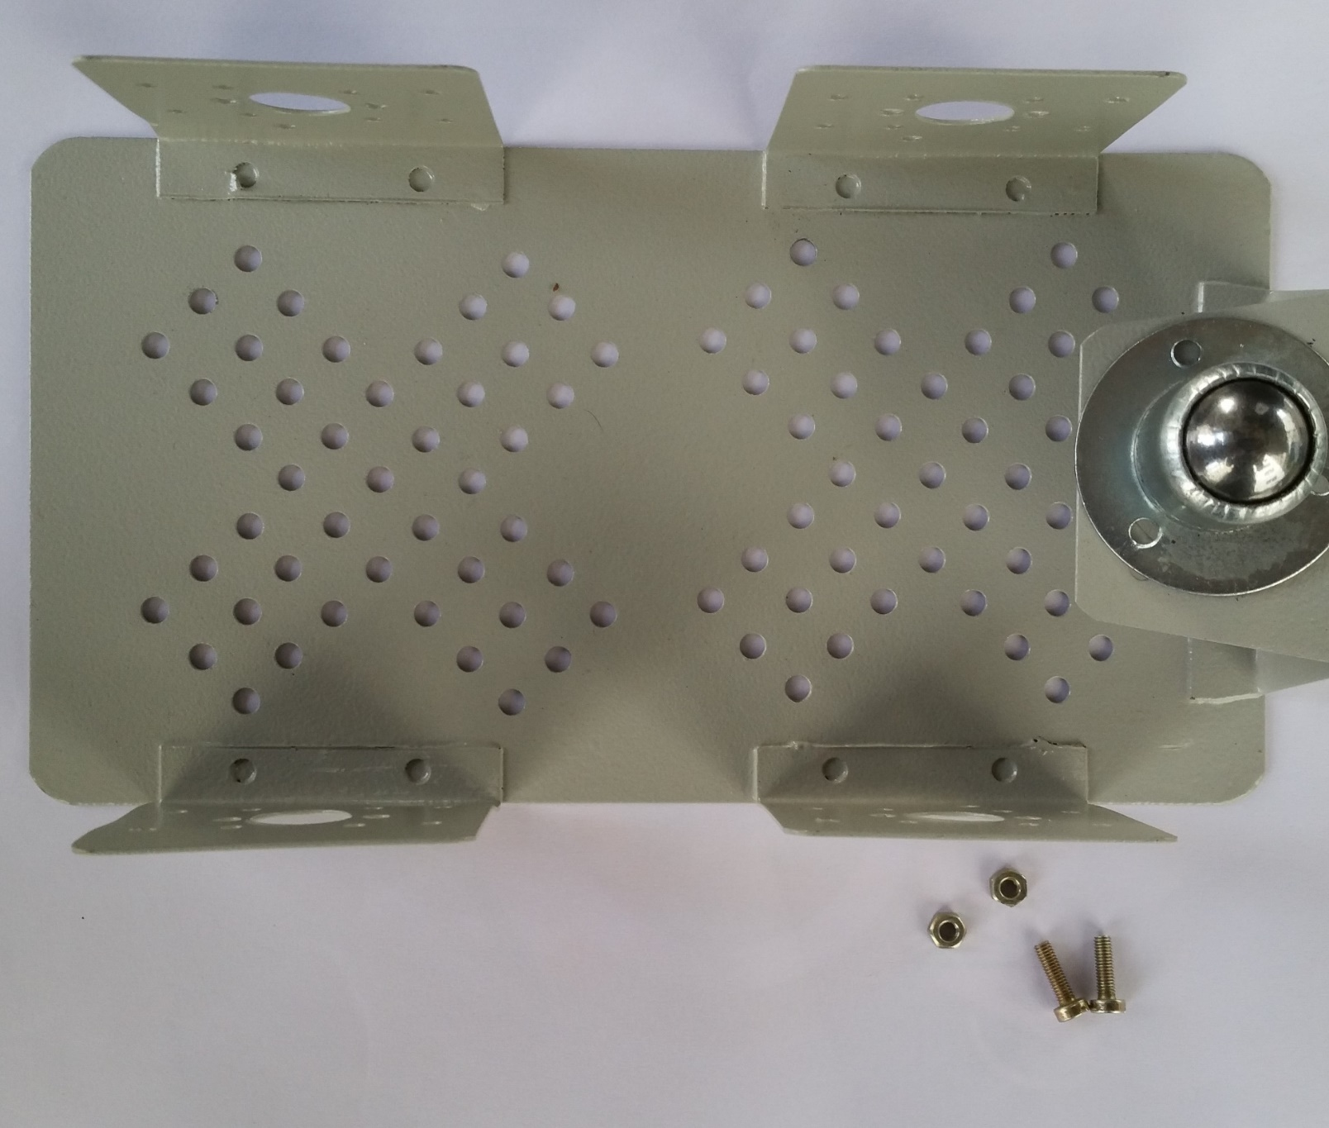

Slide 13
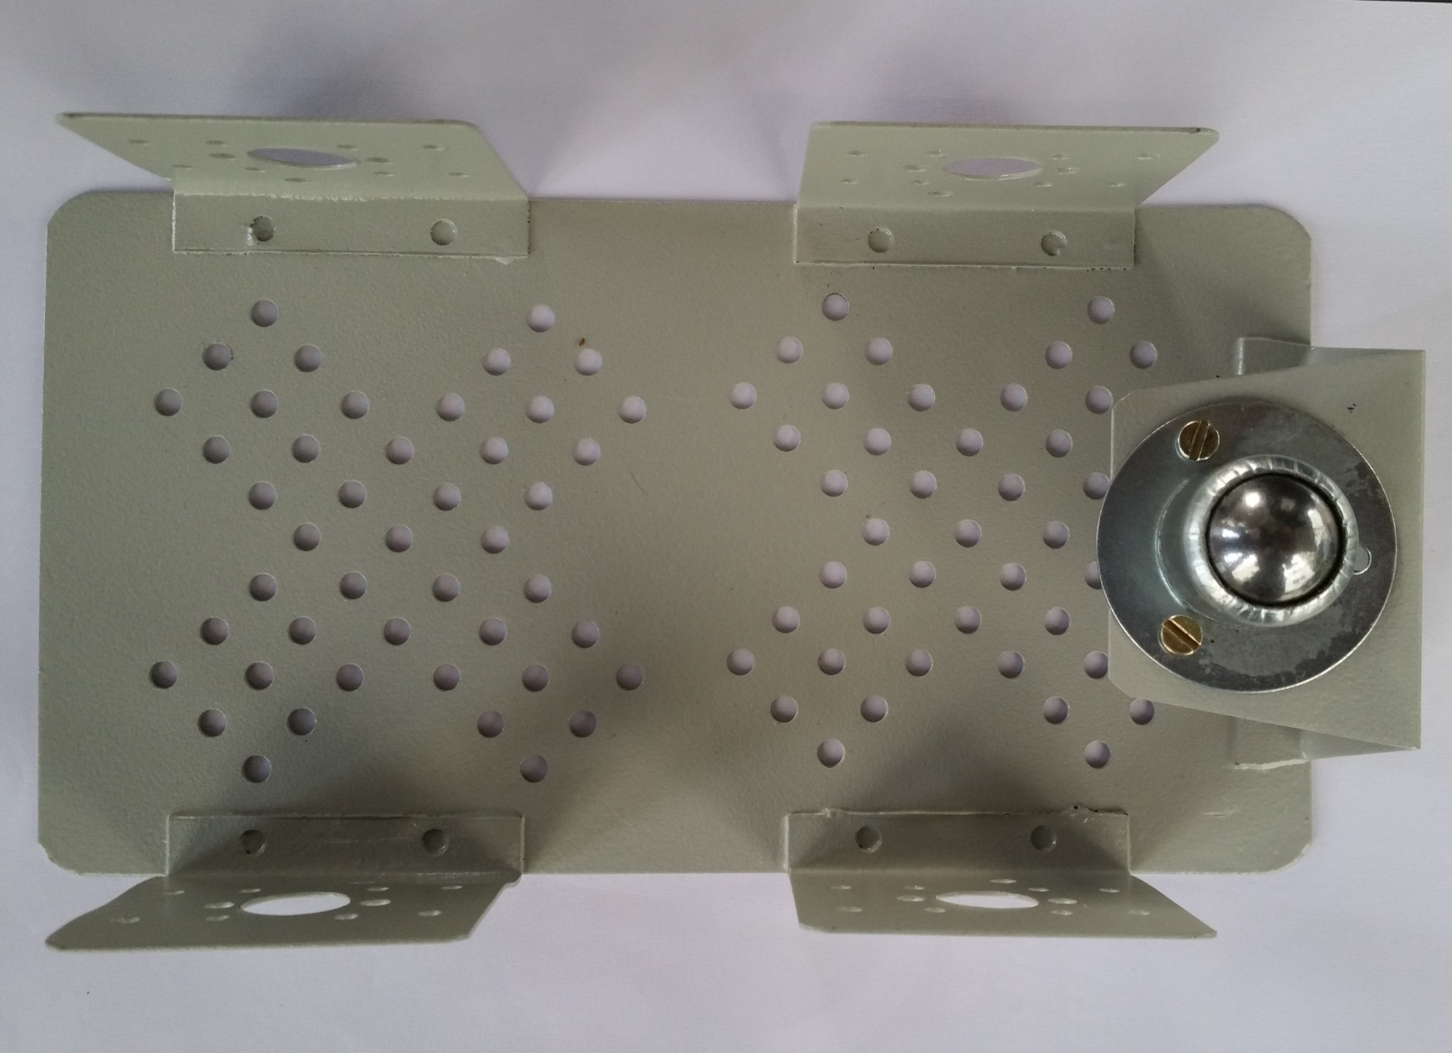

Slide 14
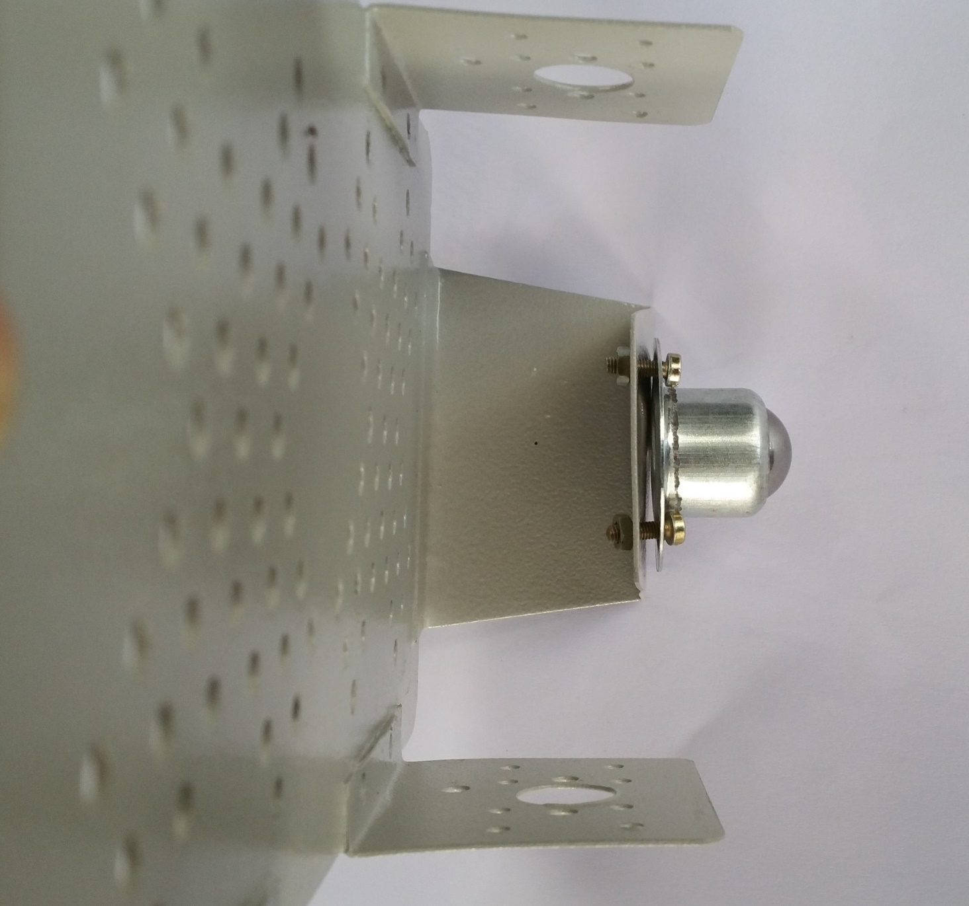

Slide 15
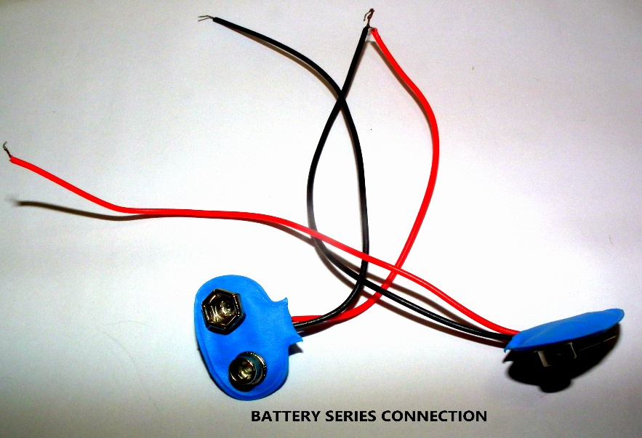
Connections: Battery Series Connection
The two battery packs have to be connected in SERIES to collectively supply 12V.
The BLACK wire from one clip is connected to the RED wire of the other clip.
The other wires are connected to the power supply.

Slide 16
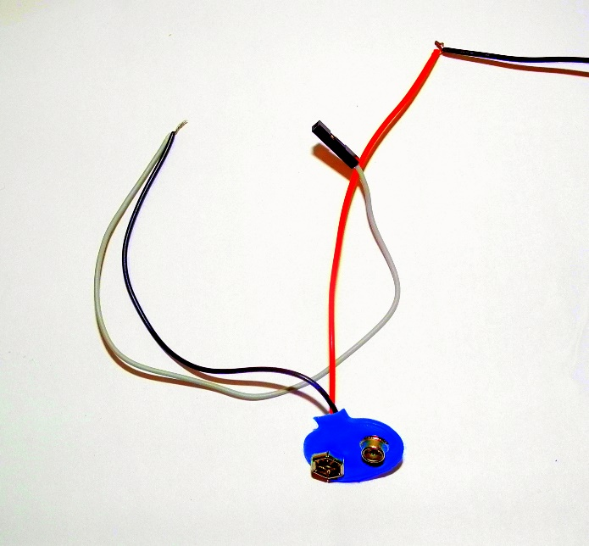
Connections: Grounded Jumper Wire
A jumper wire is connected to the GROUND port in the power supply.
The other end is connected to the GROUND PIN on the Arduino.

Slide 17
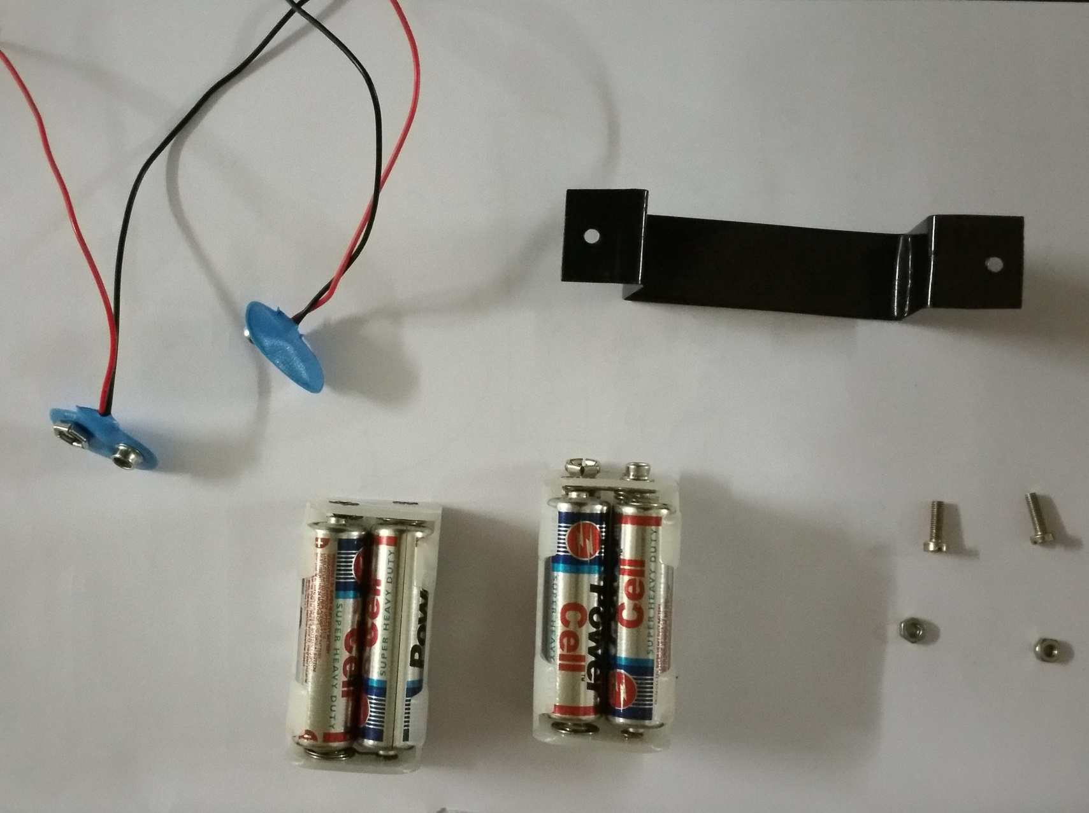

Slide 18
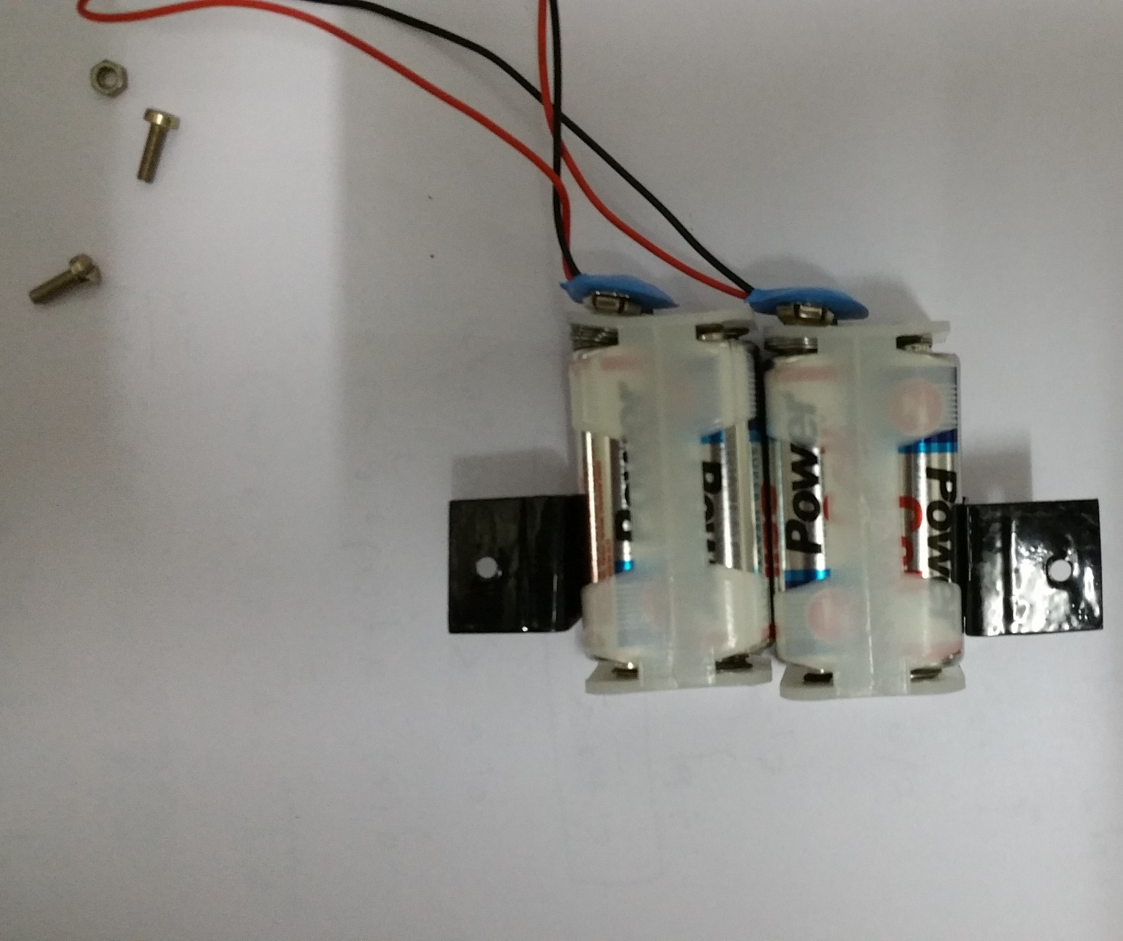

Slide 19
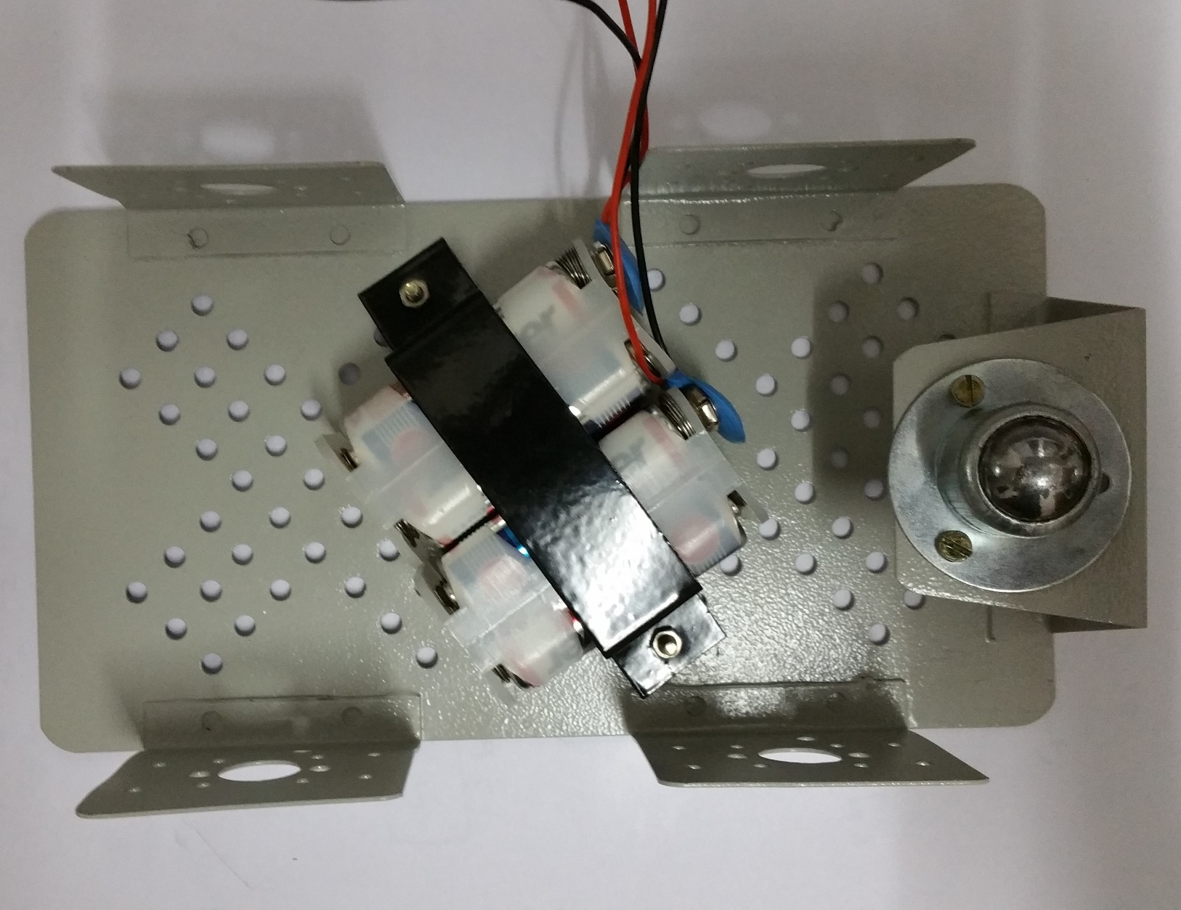

Slide 20
Attaching Boards :
Take the Arduino board and attach it using spacers on the upper side of the chassis .
Take the L293D motor driver board and attach it using spacers on the upper back side of the chassis.

Slide 21
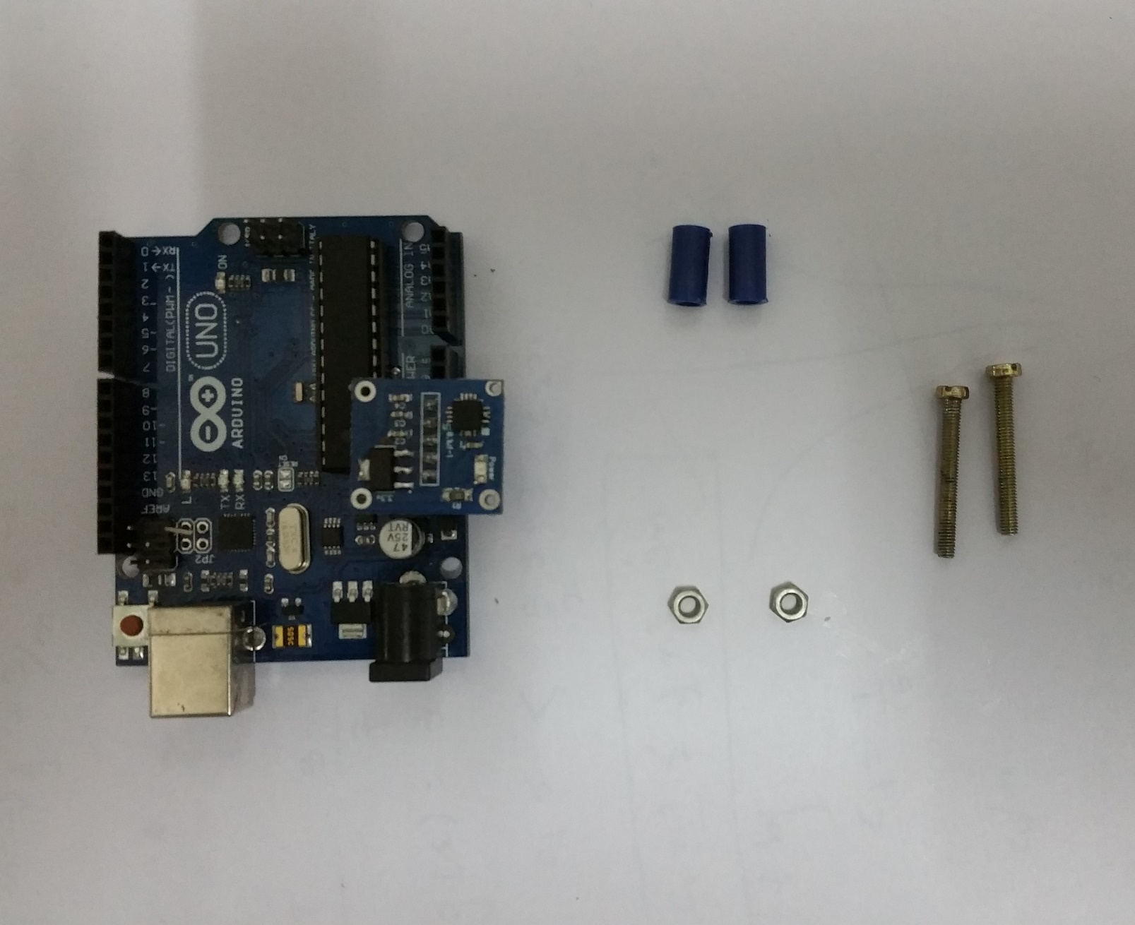

Slide 22
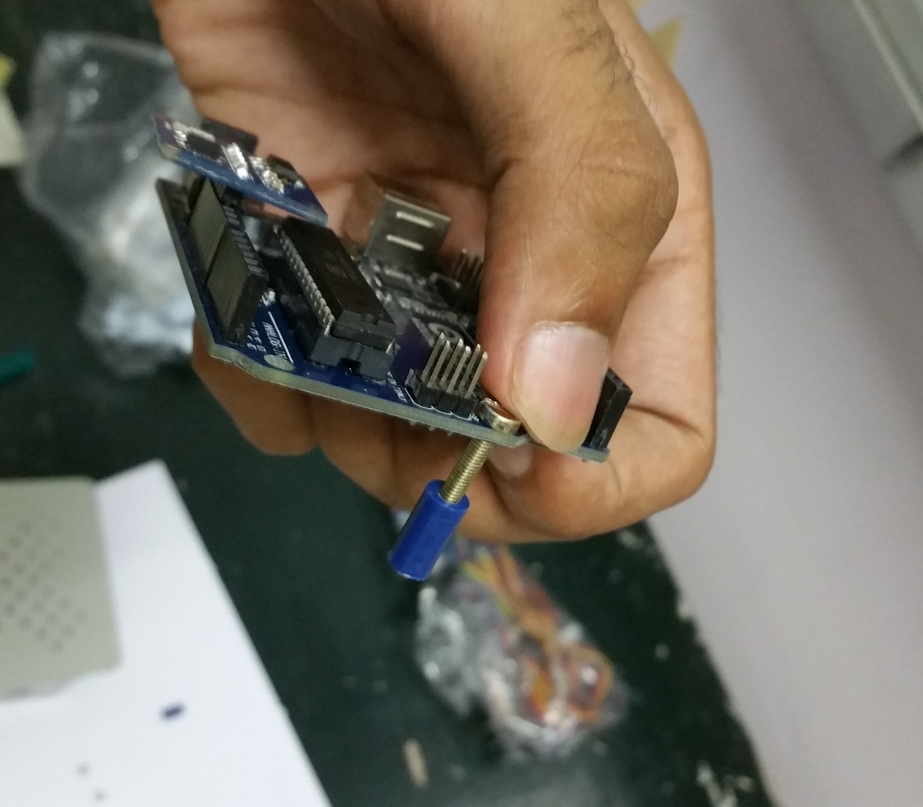

Slide 23
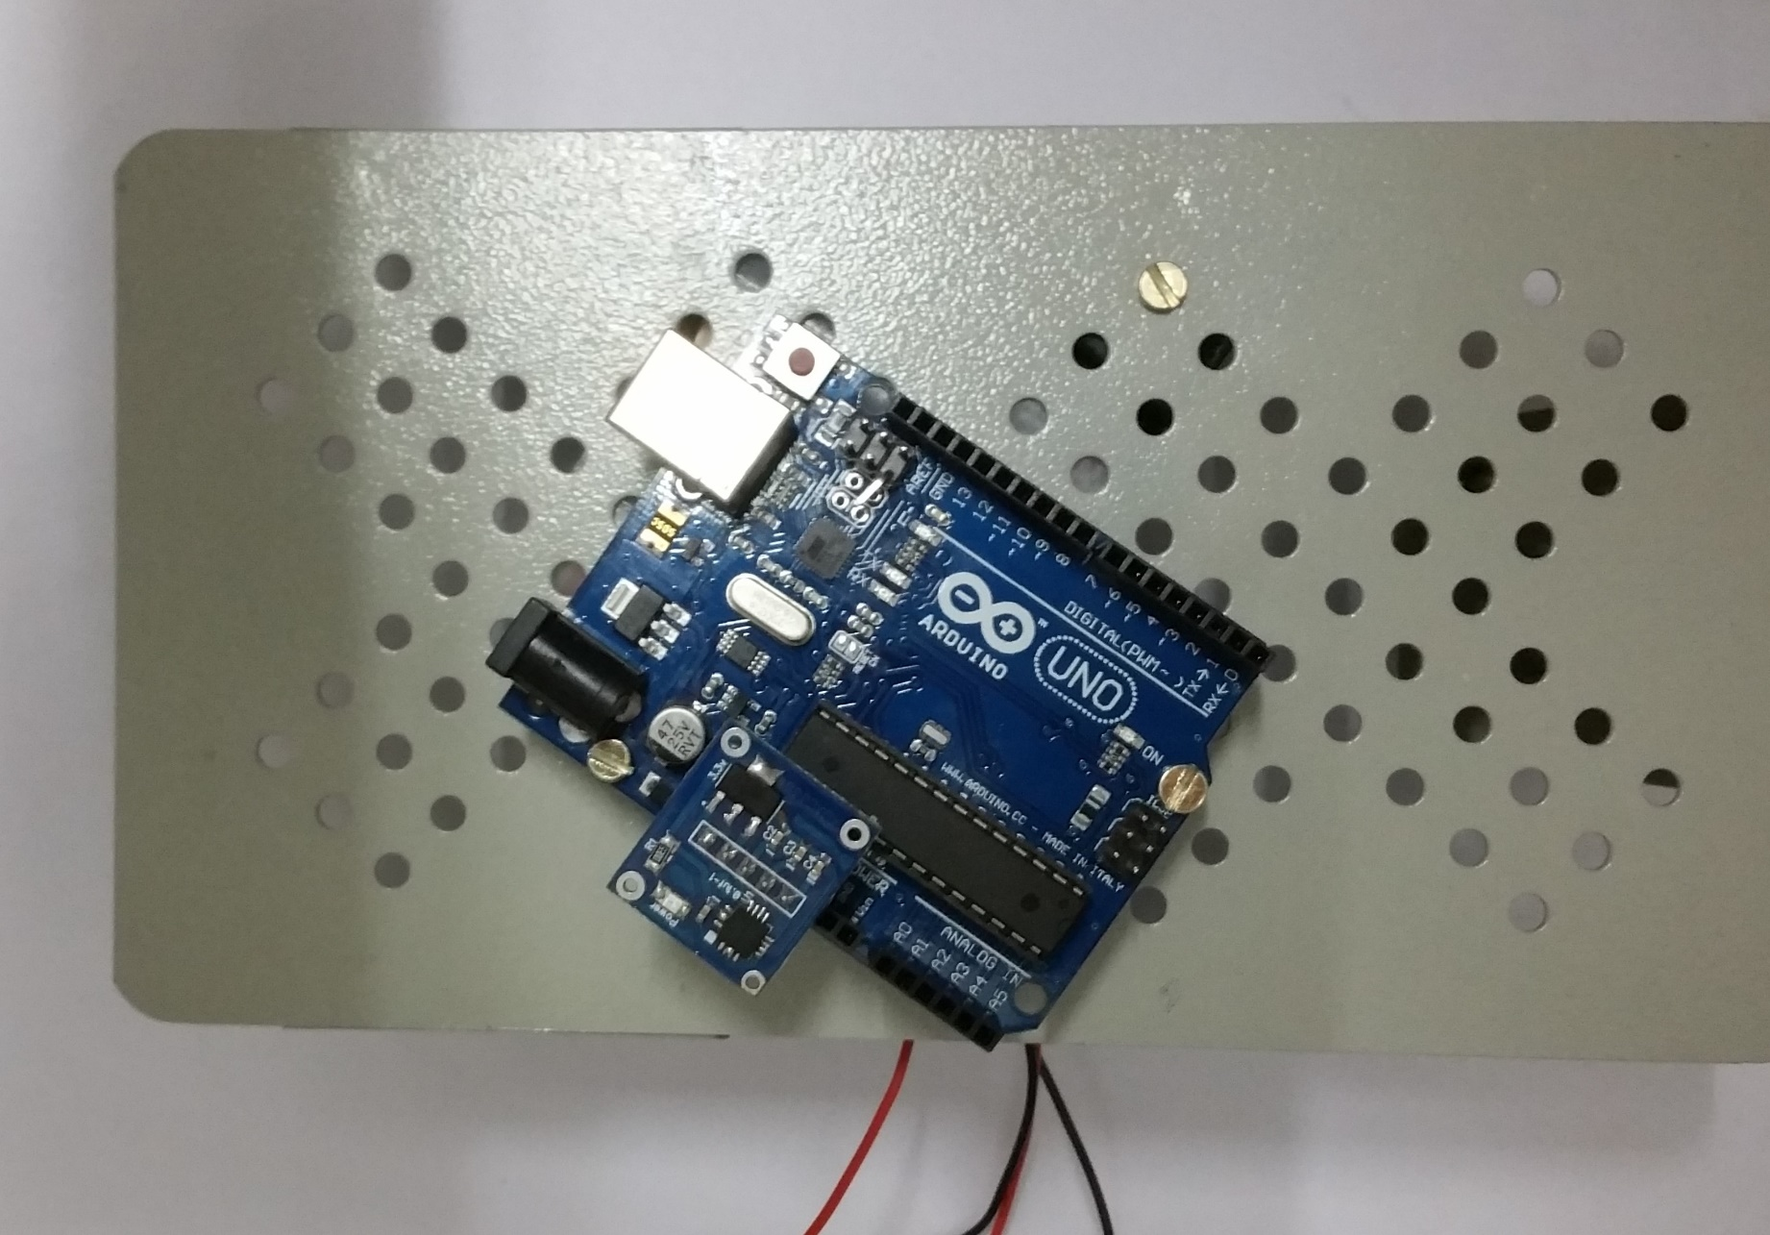

Slide 24
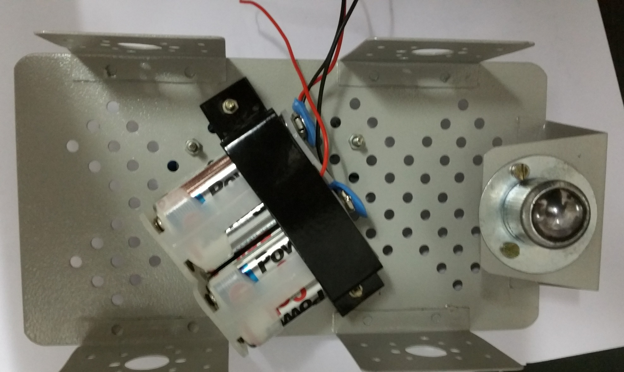

Slide 25
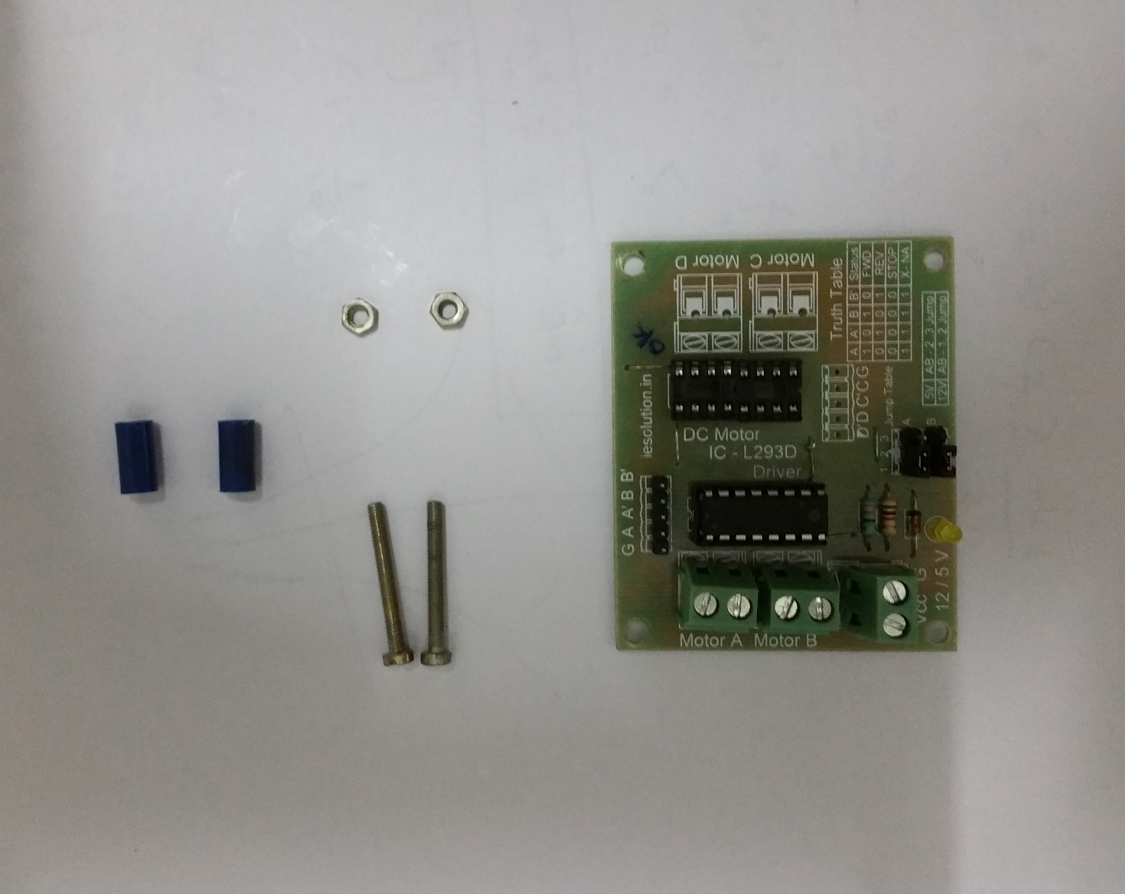

Slide 26
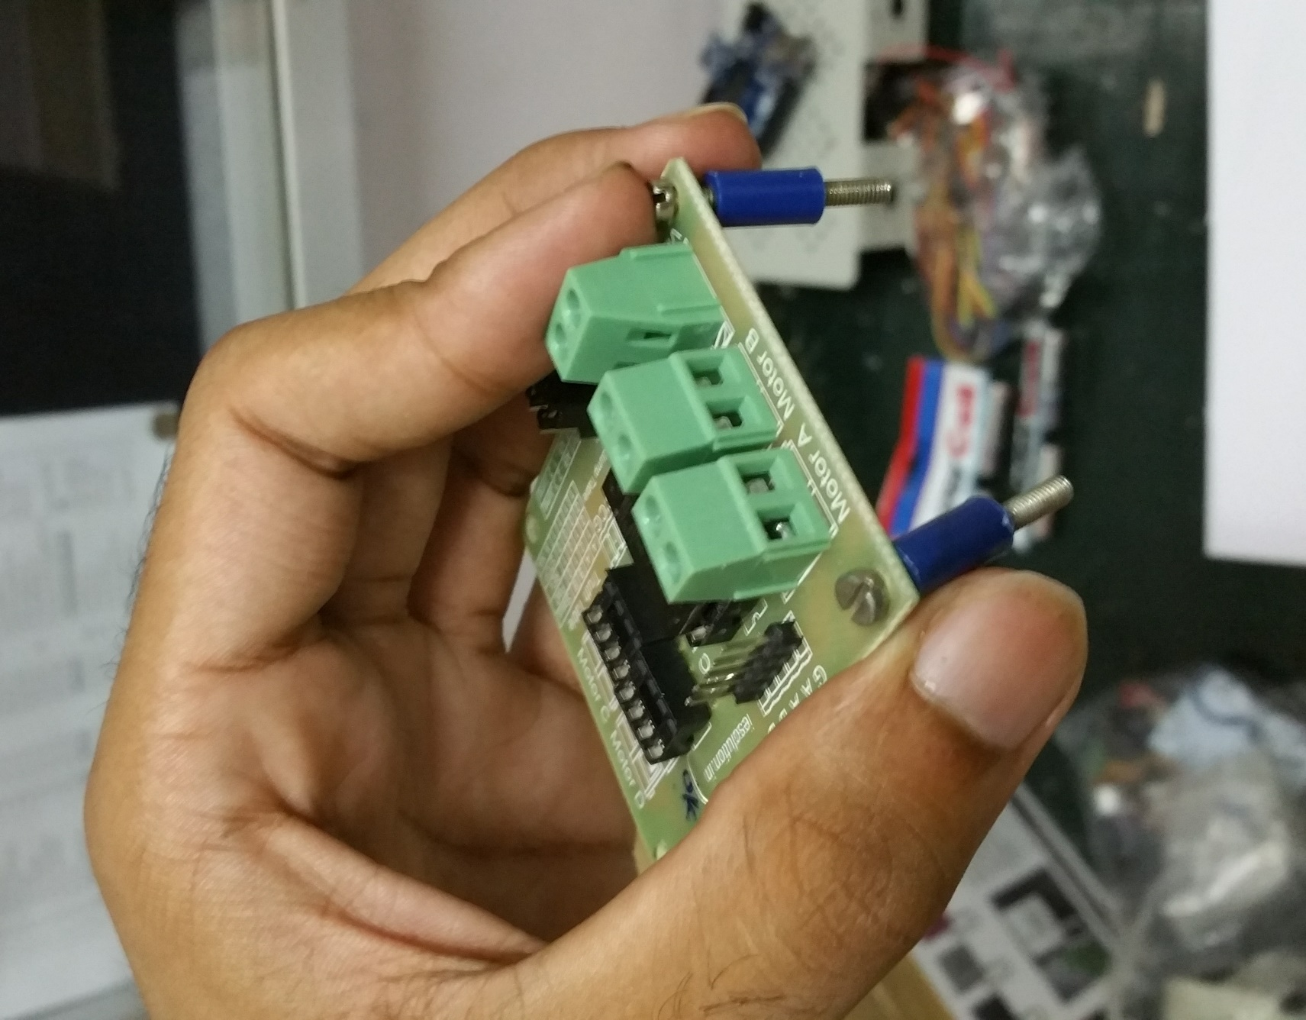

Slide 27
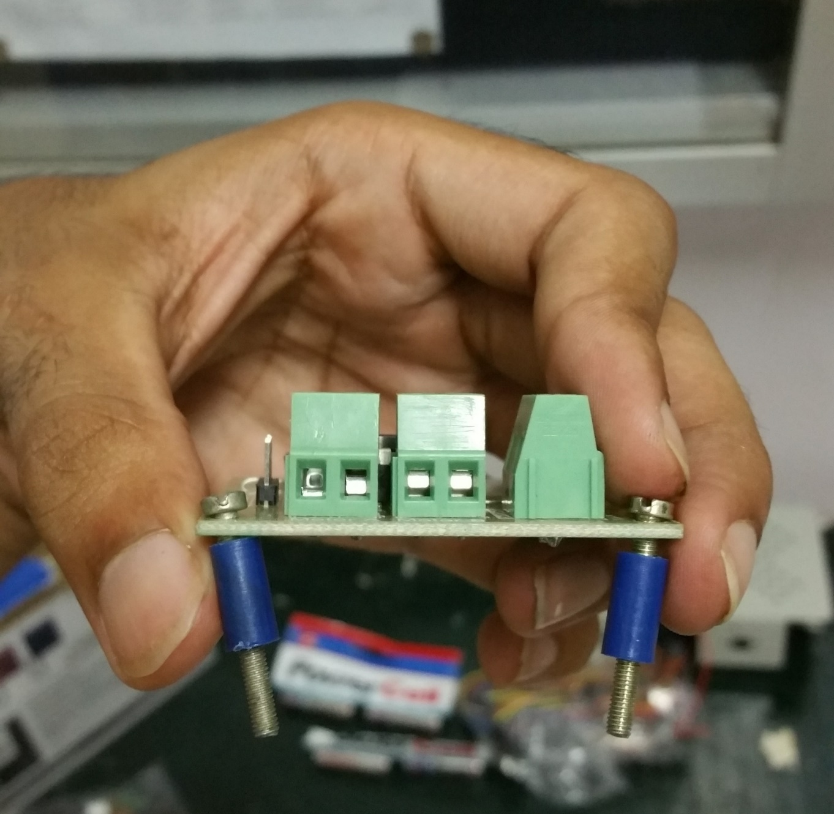

Slide 28
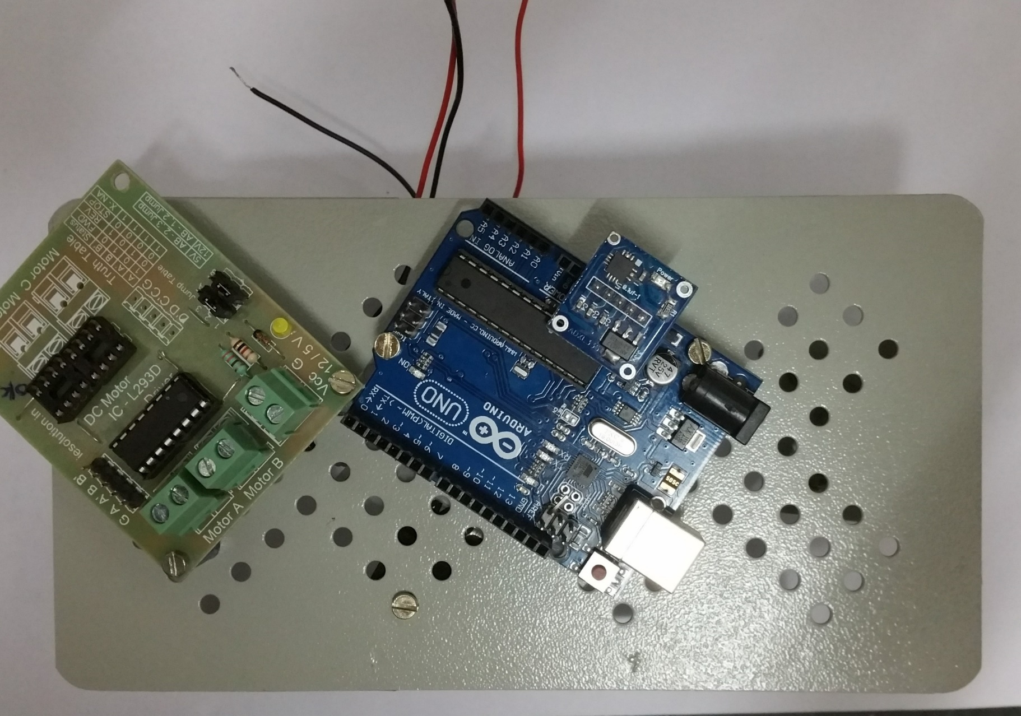

Slide 29
Motor Assembly:
Attach the motors to the L- clamp.
Fix the wheels with the motors using screws.

Slide 30
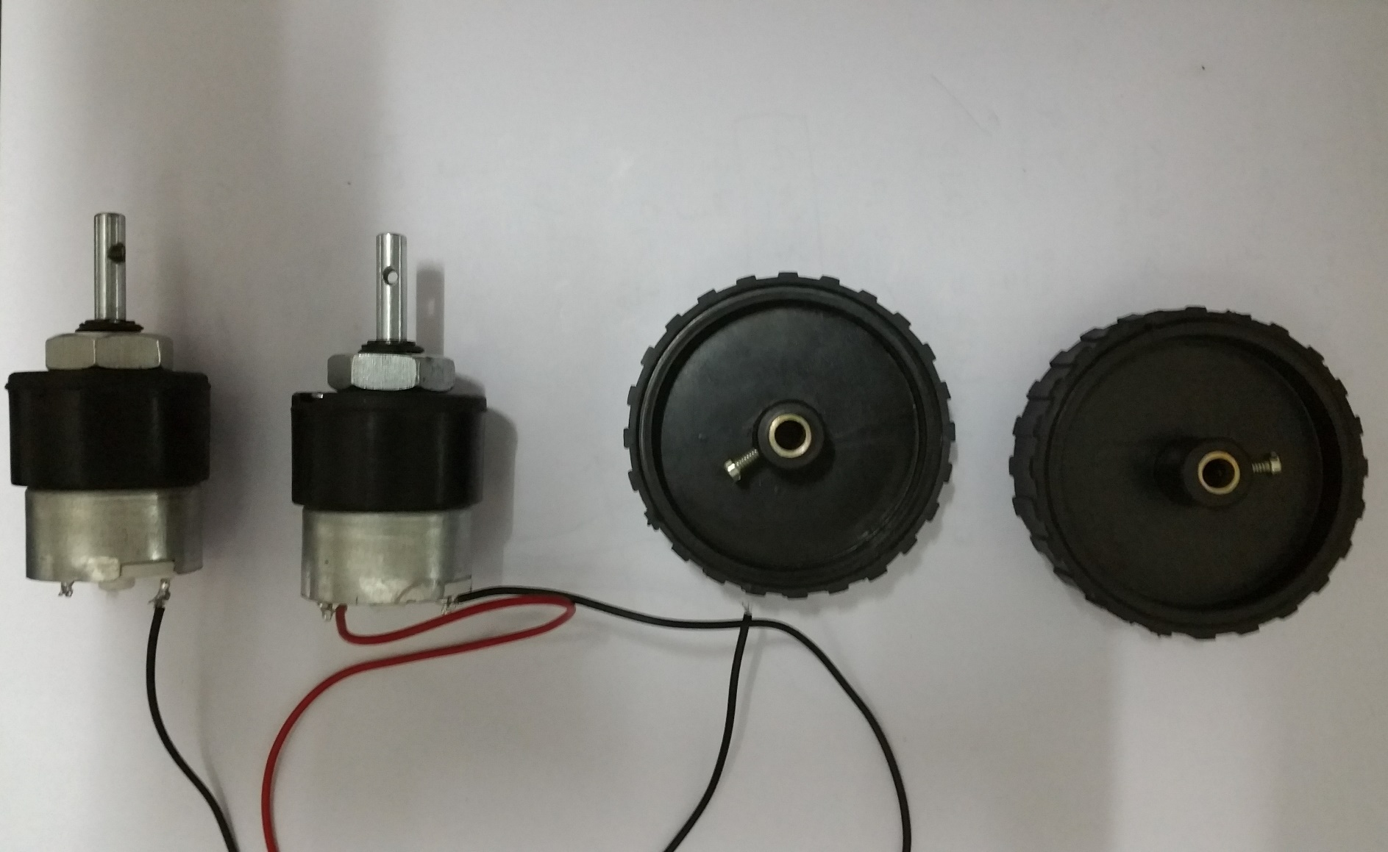

Slide 31
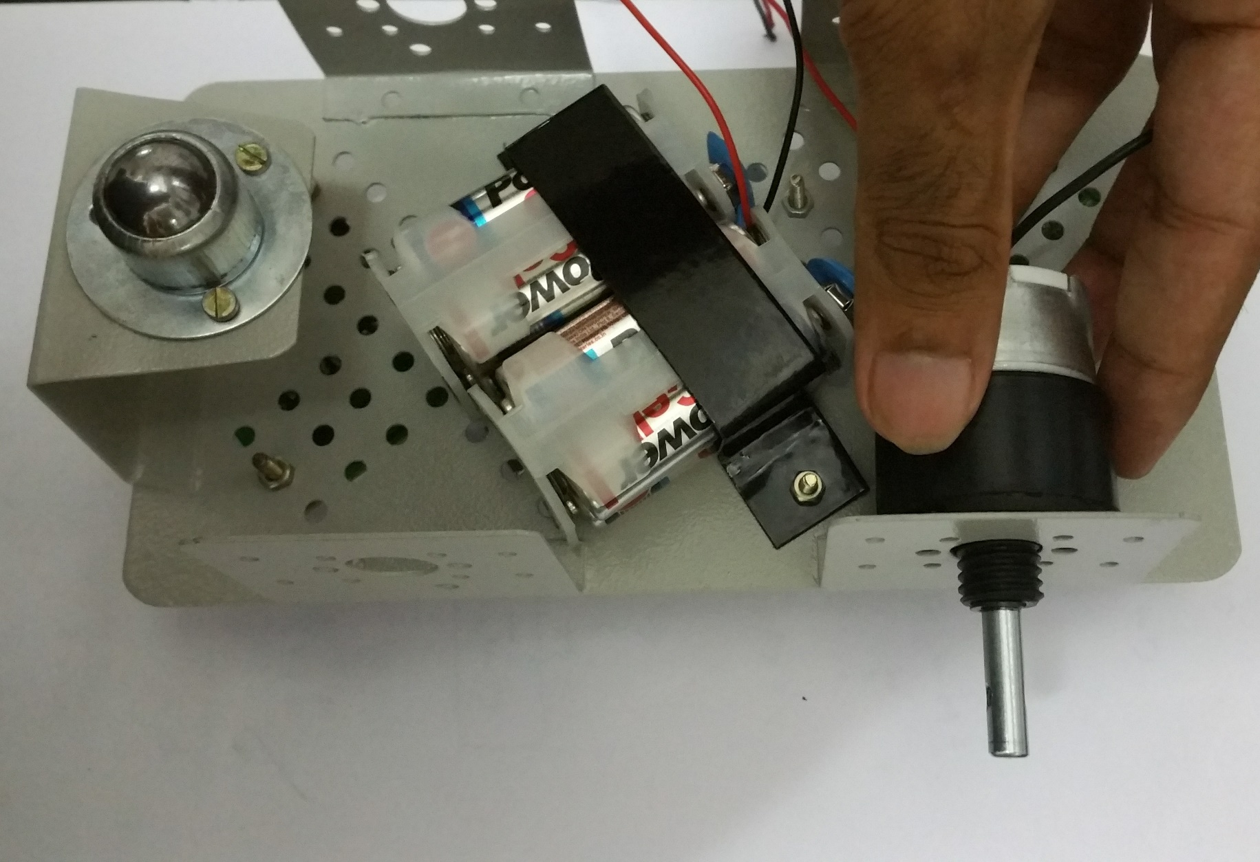

Slide 32
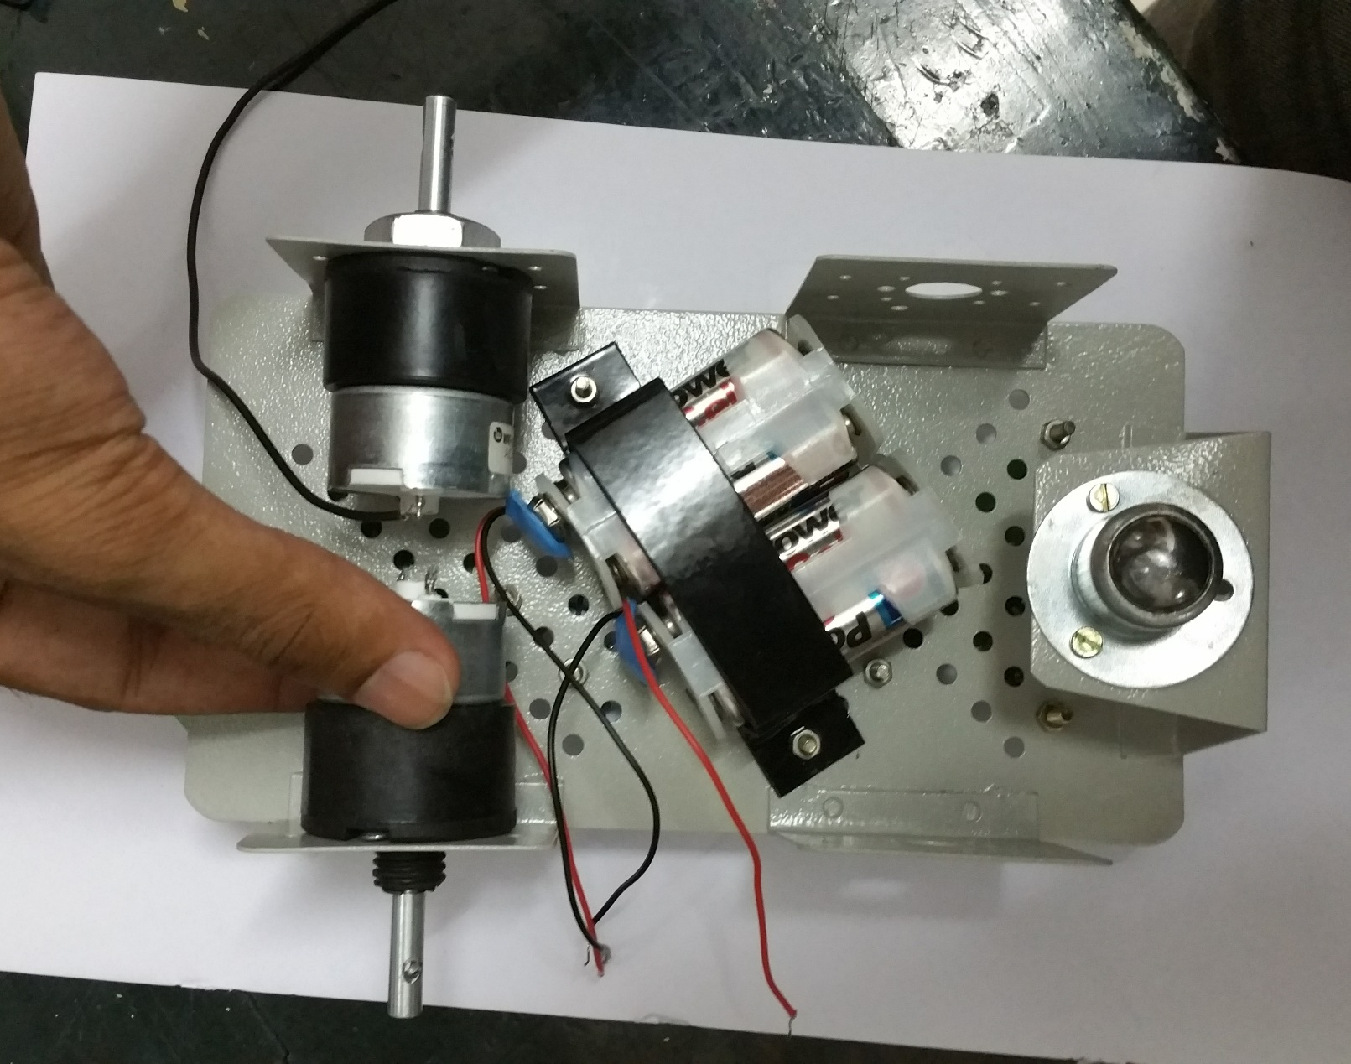

Slide 33
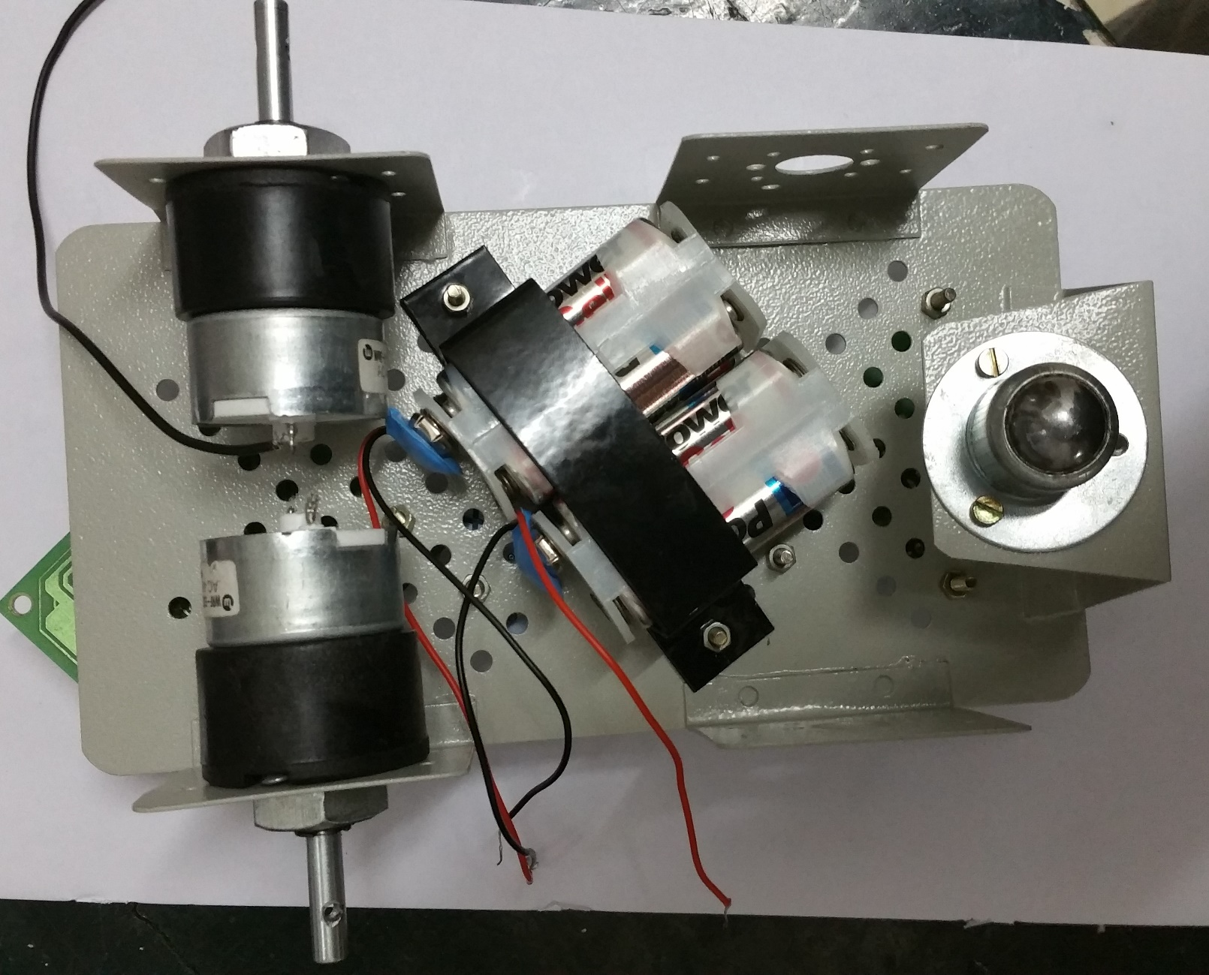

Slide 34
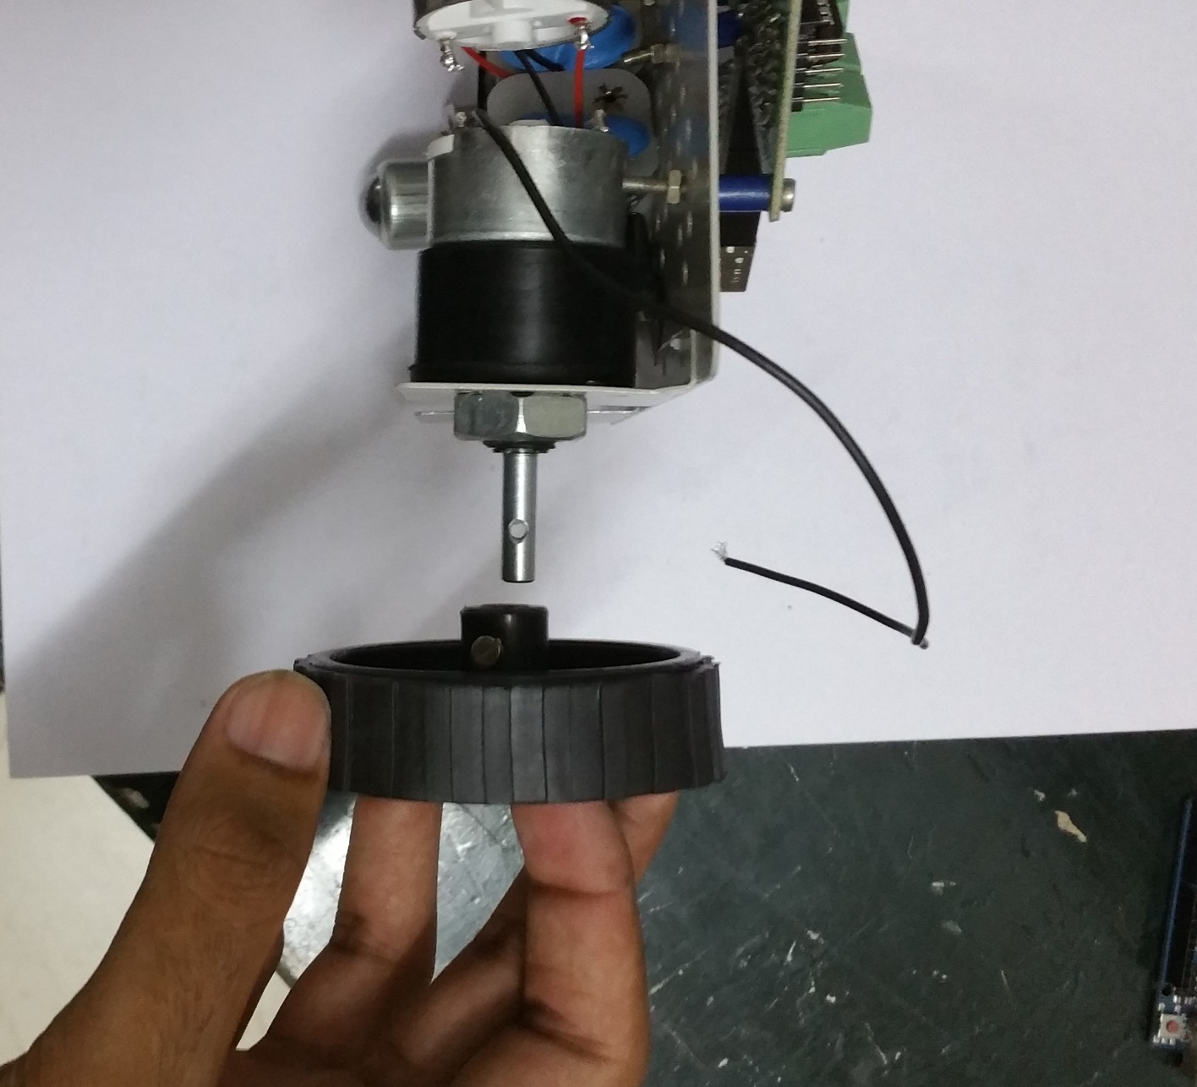

Slide 35
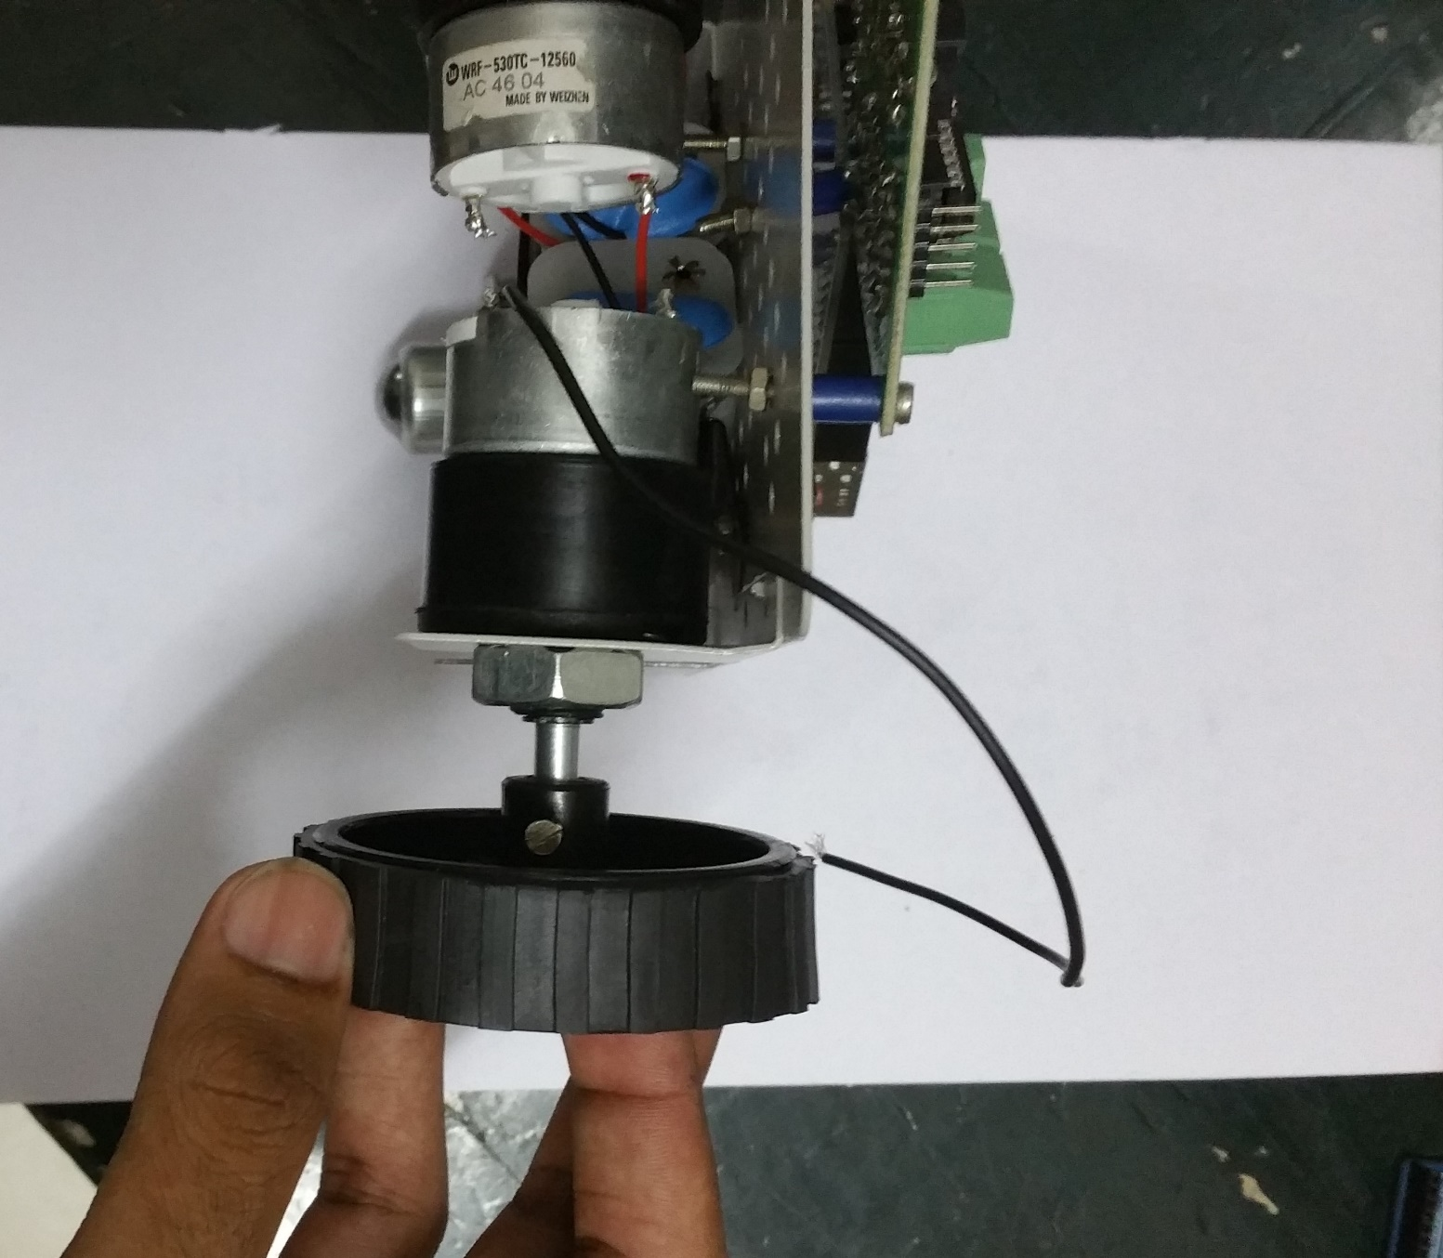

Slide 36
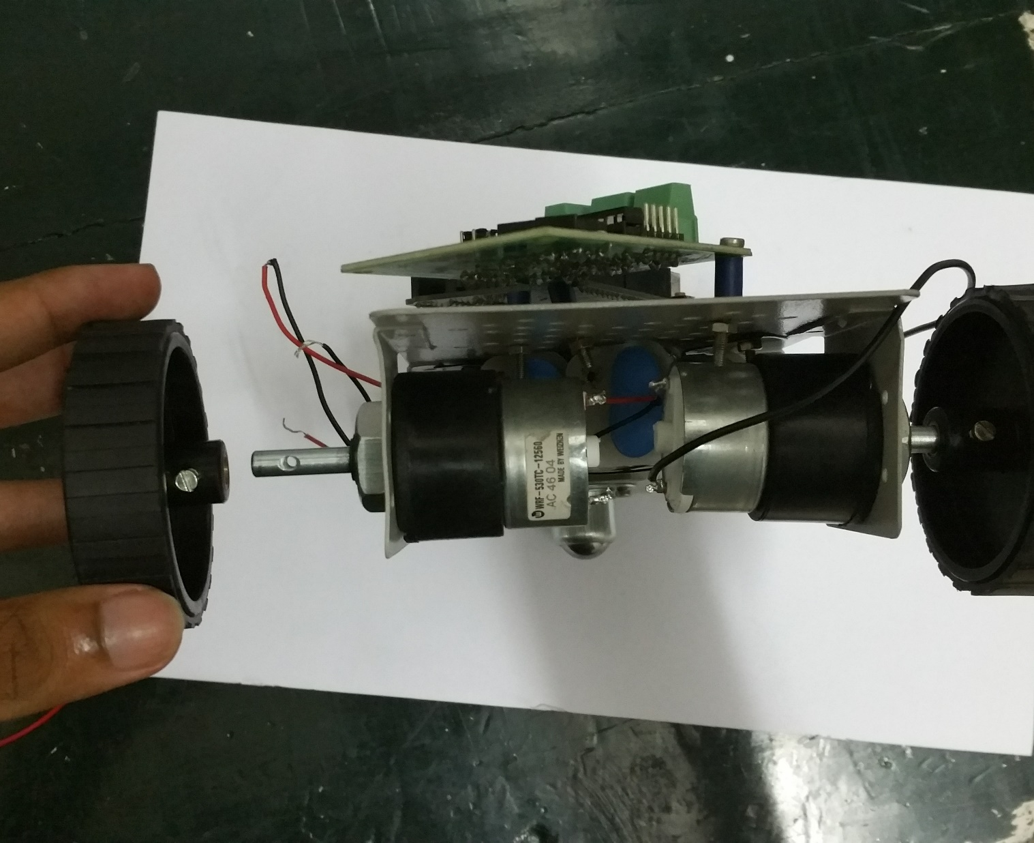

Slide 37
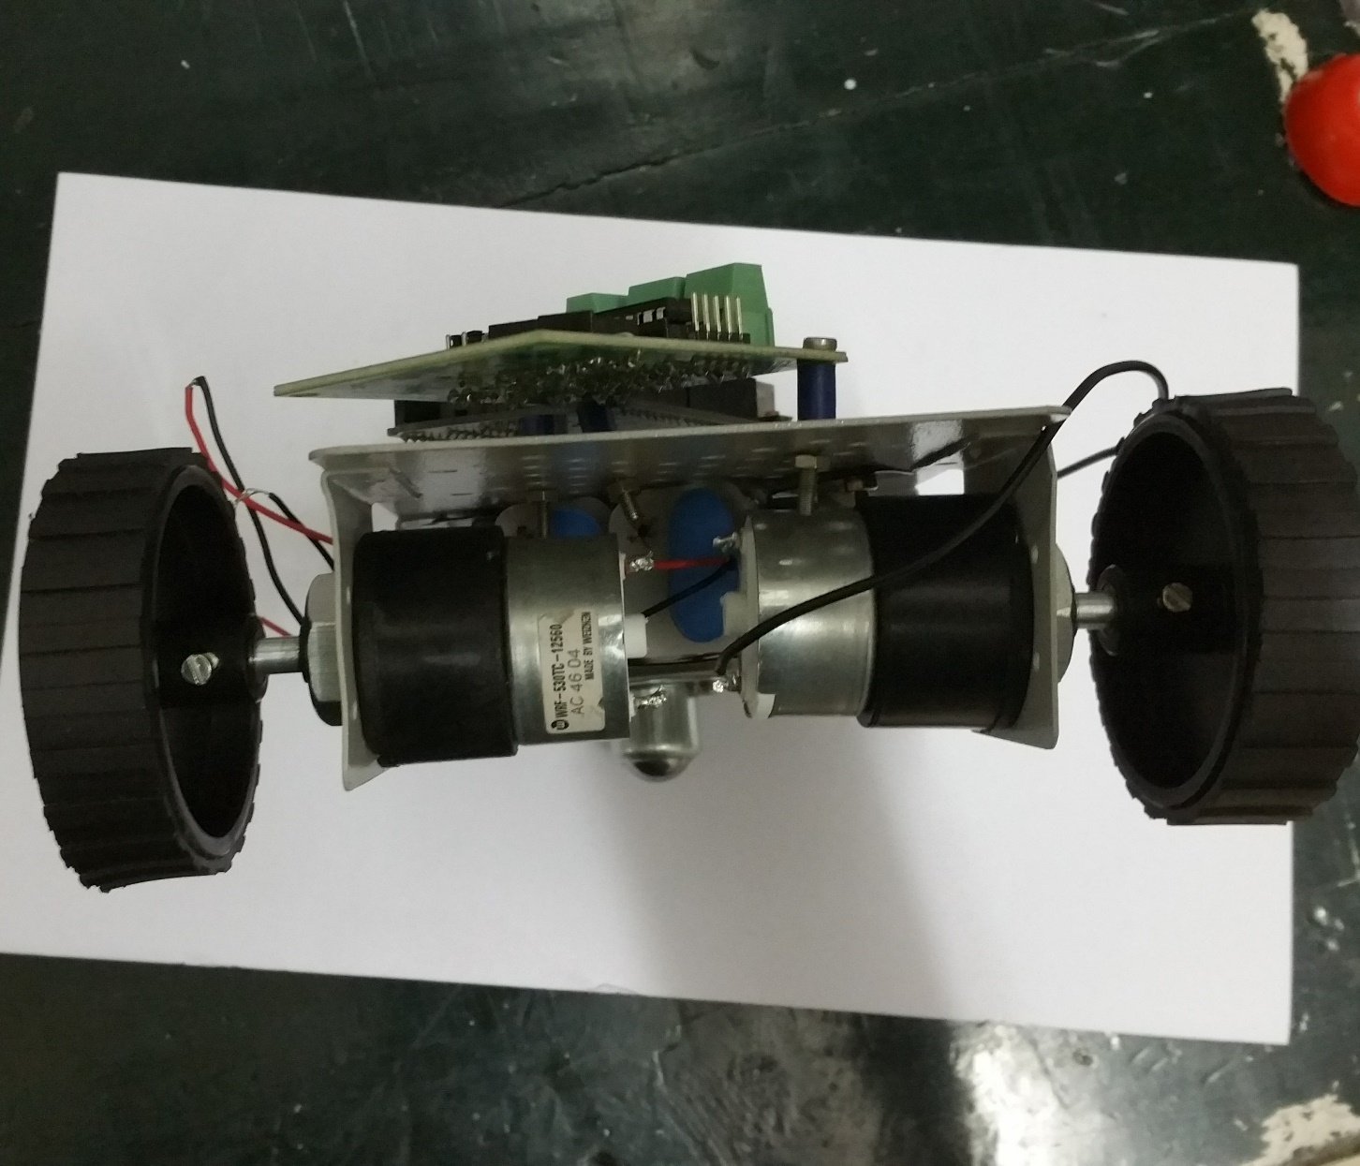

Slide 38
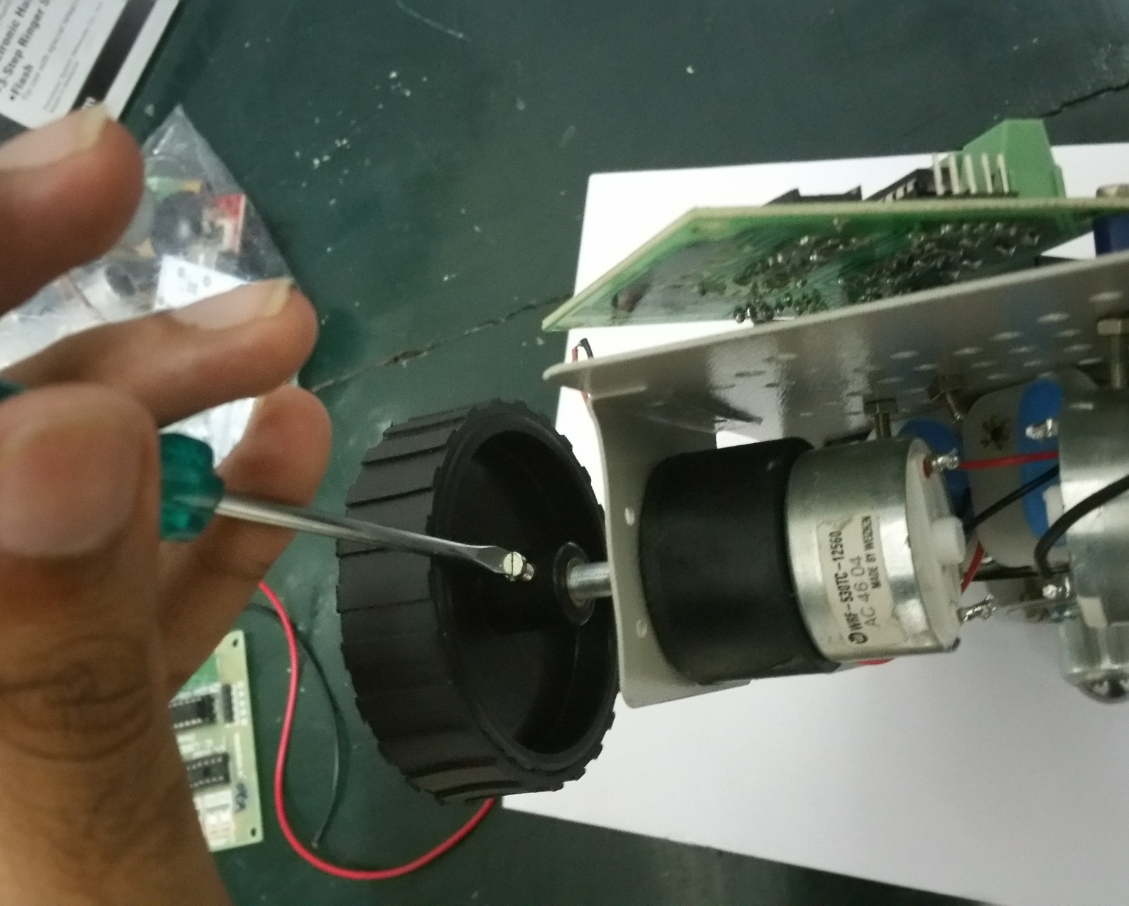

Slide 39
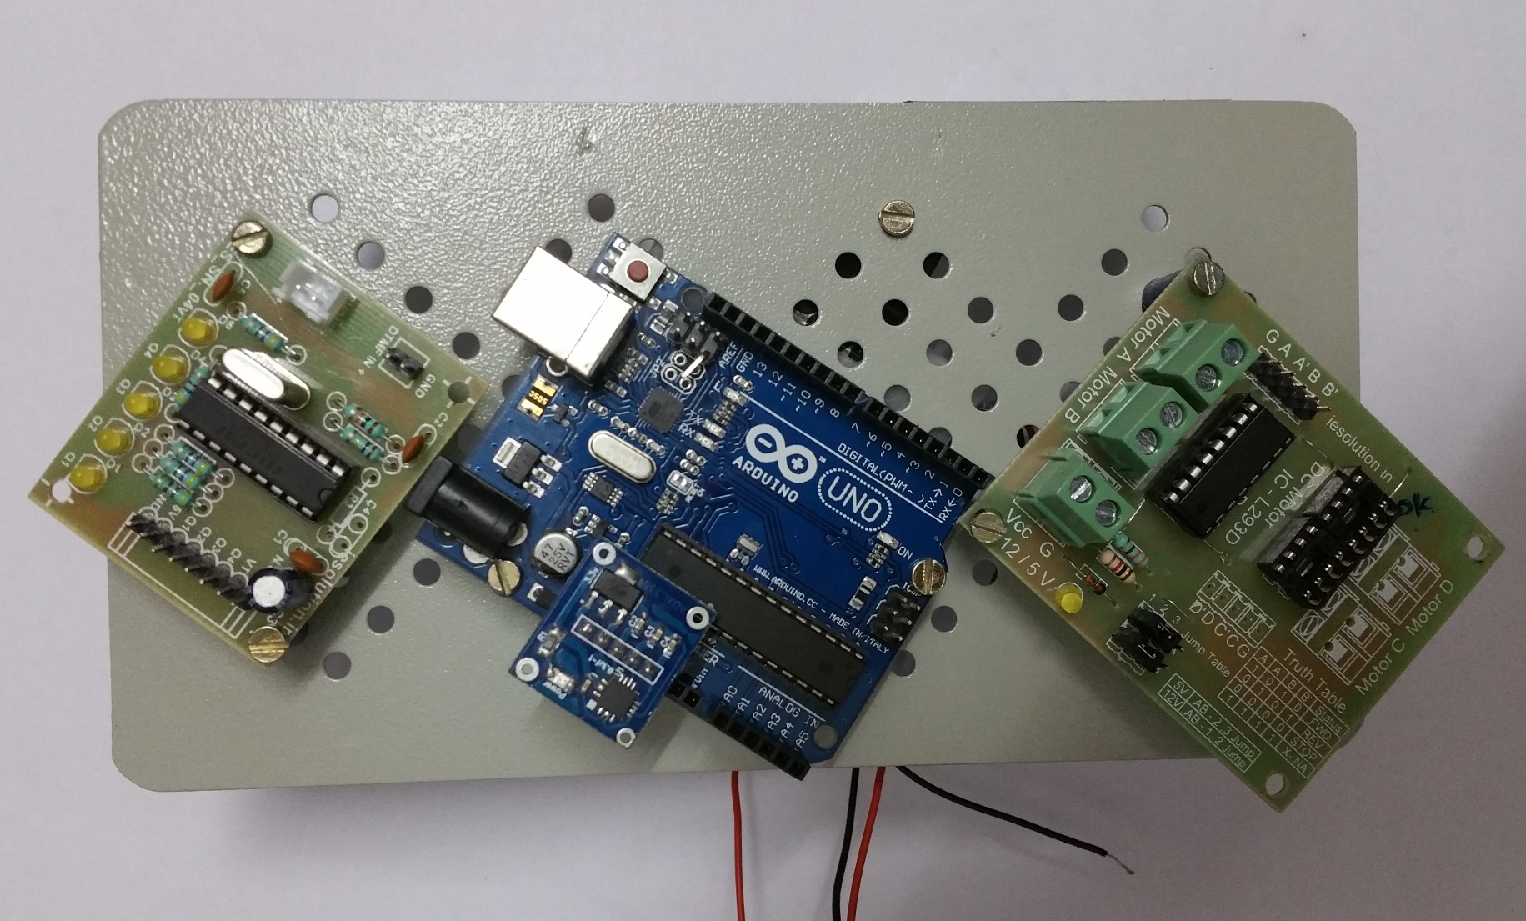

Slide 40

Connections: L293D J3 Pin
The Arduino board uses a 5V supply to function.
The J3 pin on the L293D board supplies 12V voltage to Arduino board, hence strictly should NOT be used.
The pin C1 (beside J3 pin) should be USED at all times.

Slide 41
Connections: Arduino Power Supply
The Arduino board can be powered using two sources – A USB cable or the L293D board.
The power supply mode can be switched using the PWR-SEL pins.
The jumper pin should be on the SEL side at all times.

Slide 42
Connections: Motors -> L293D
The Motors have a RED wire and a BLACK wire.
Each of these wires is to be connected to MOT-A and MOT-B ports on the L293D.
The BLACK wire is to be connected to the side the port labels are printed on as illustrated below.

Slide 43
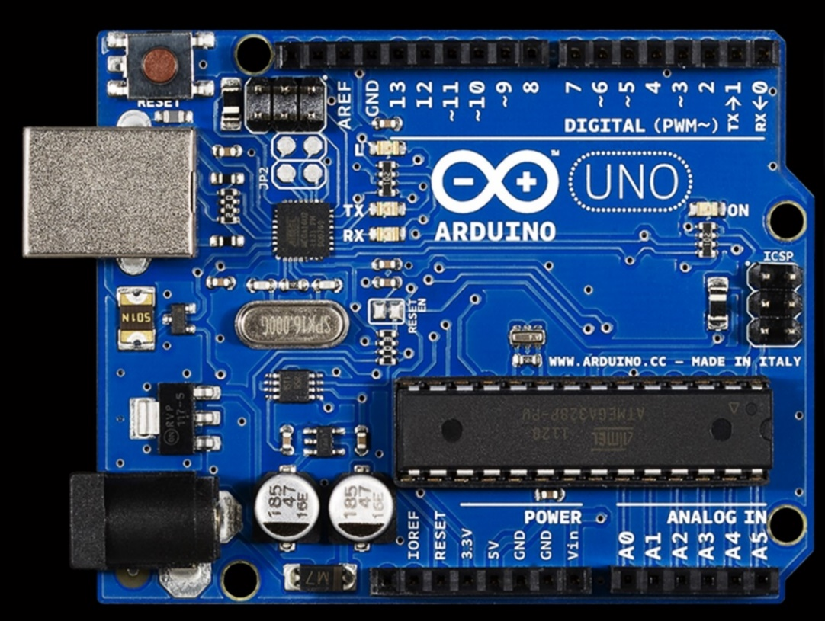
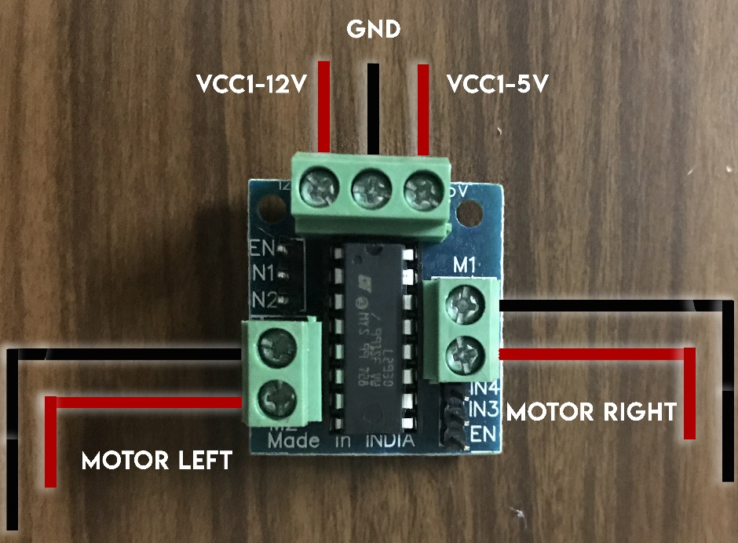

Slide 44
Connections: Arduino -> L293D
The following connections have to be made between the two boards :
A -> PIN 5
A’ -> PIN 4
B -> PIN 3
B’ -> PIN 2
Note : The pins mentioned are the Digital Pins and not the Analog ones.

Slide 45
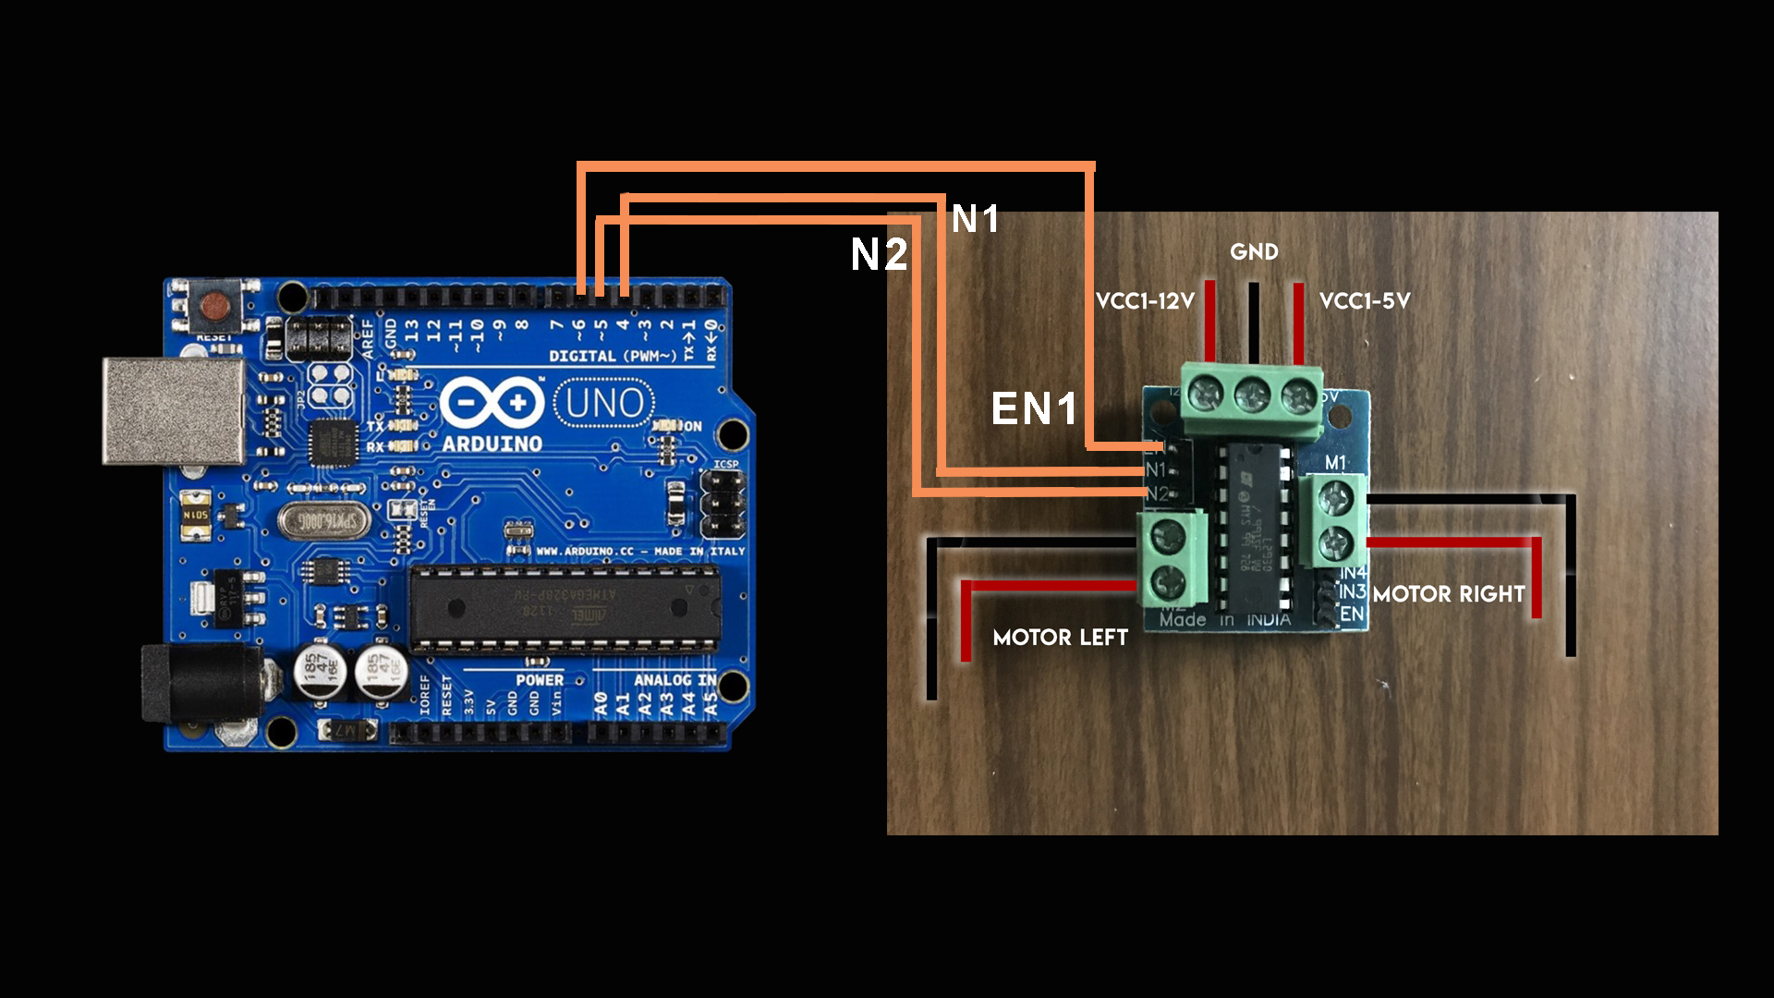

Slide 46
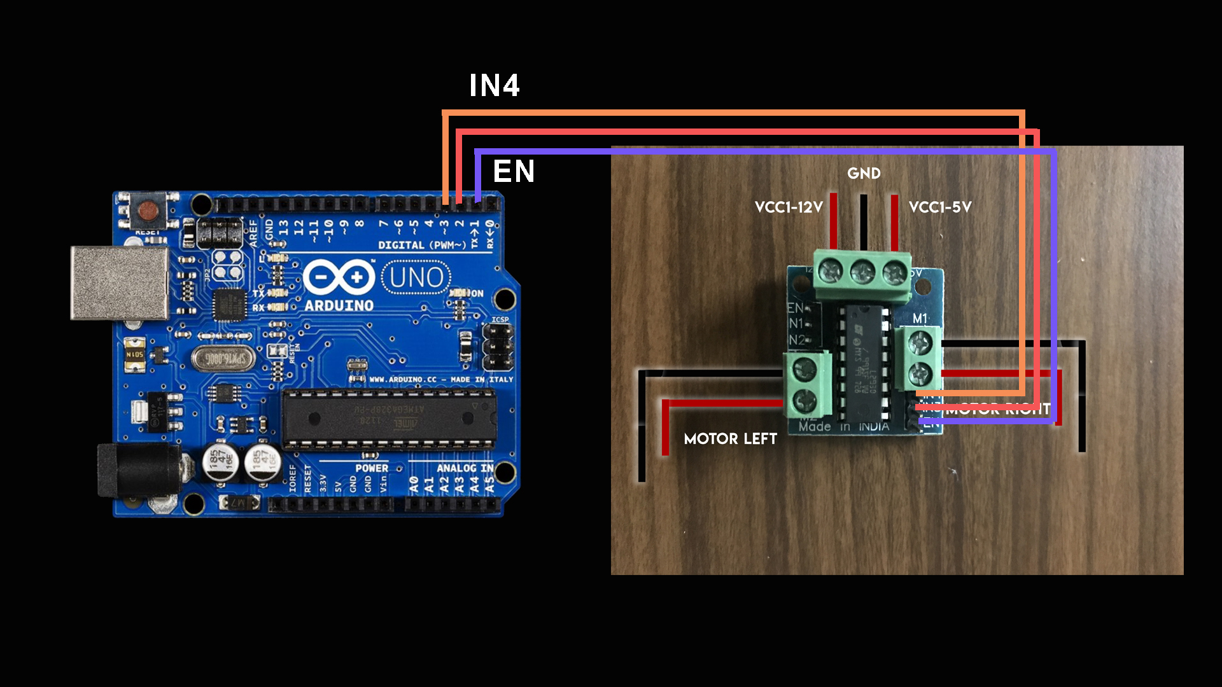

Slide 47
IDE Installation
IMPLEMENTATION SESSION

Slide 48
Installing Arduino IDE :
Open “Robotix” Folder.
Open “softwares” Folder.
Run arduino-1.0.5-windows.exe if using a PC
Or copy arduino.app to your desktop for MAC
Install the software by following the on-screen instructions.

Slide 49
Installing Drivers:
Open folder Robotix
Choose your version of driver depending on your OS
Extract the files
Run CDM v2.08.30 WHQL Certified.exe or mac os x 32 bit----FTDIUSBSerialDriver_v2_2_18.dmg (depending on your version of mac OS)
Install the driver by following the on-screen instructions.

Slide 50
Settings in IDE:
Open Arduino IDE .
Go to : Tools -> board
Select Arduino Duemilanove w/ ATmega328
Connect your Arduino using USB
Go to Control Panel ->Device Manager ->Ports
See the port in which USB COM is connected.
Go to : Tools -> Port
Select same COM Port as shown in device manager.
You are now ready to upload programs.

Slide 51
Uploading Program:
Your connections are now ready.
Make sure to remove the jumper wire to the GND pin on the Arduino board coming from L293D board before uploading.
Connect the USB to the USB port.
Switch on the USB communication.
Open Arduino IDE.
Compile and upload the program.

